Slide 1




Slide 2

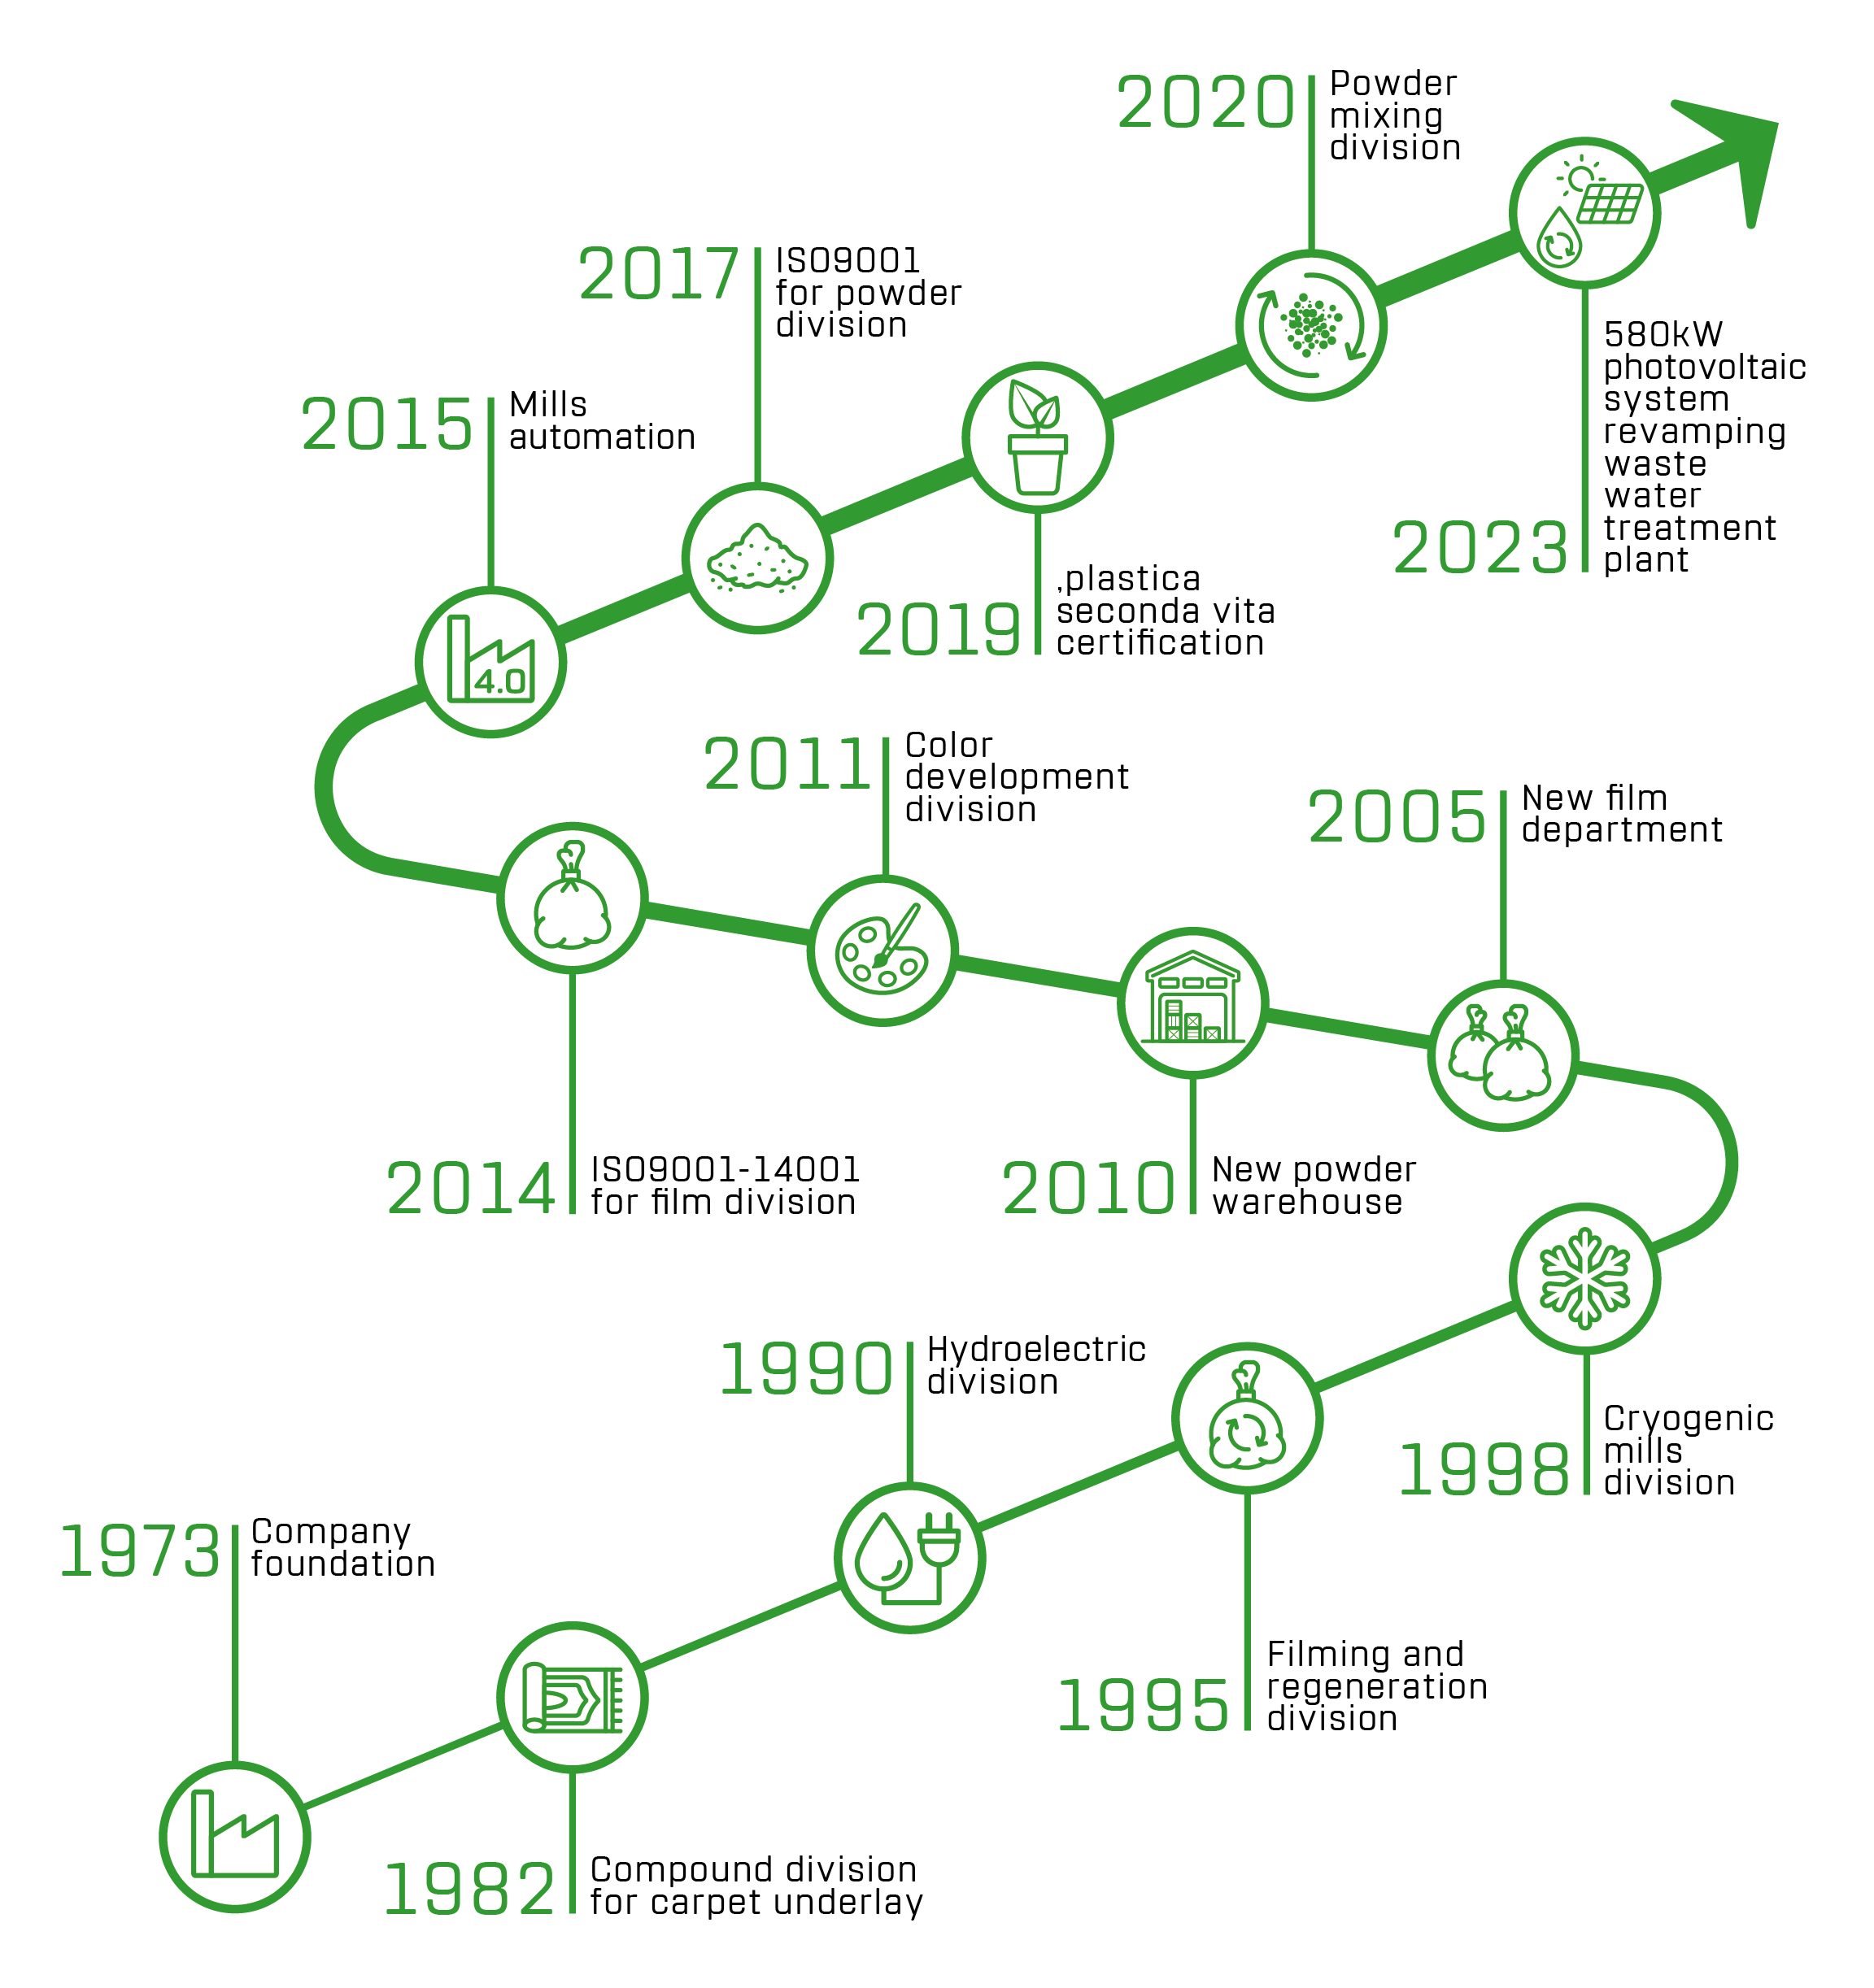

Company history

Slide 3

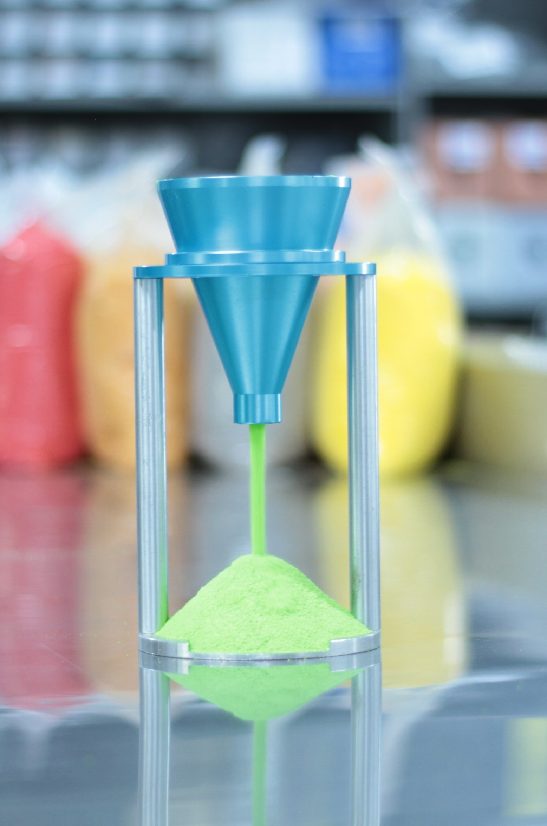
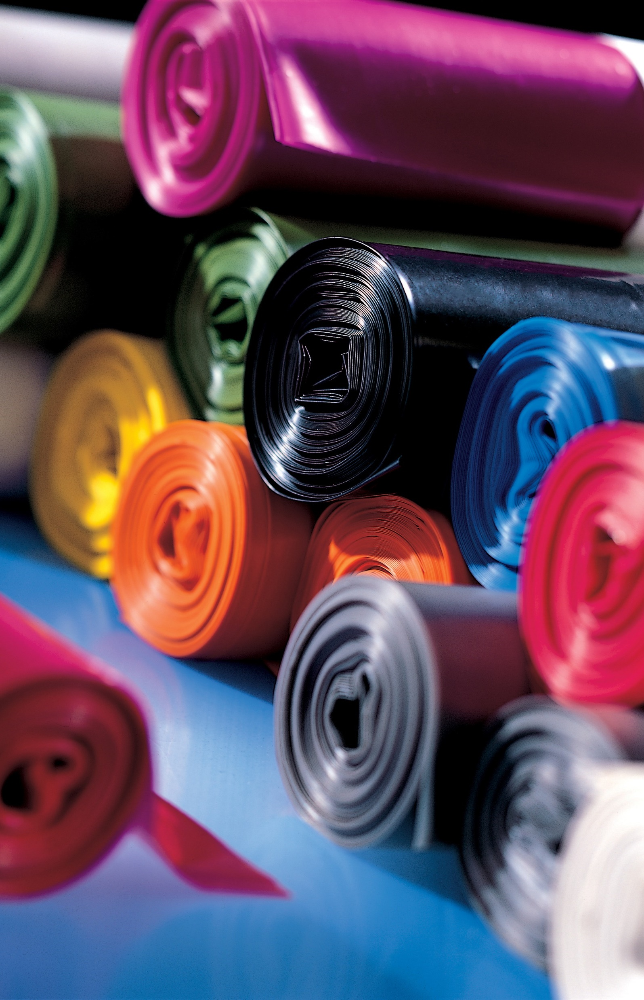
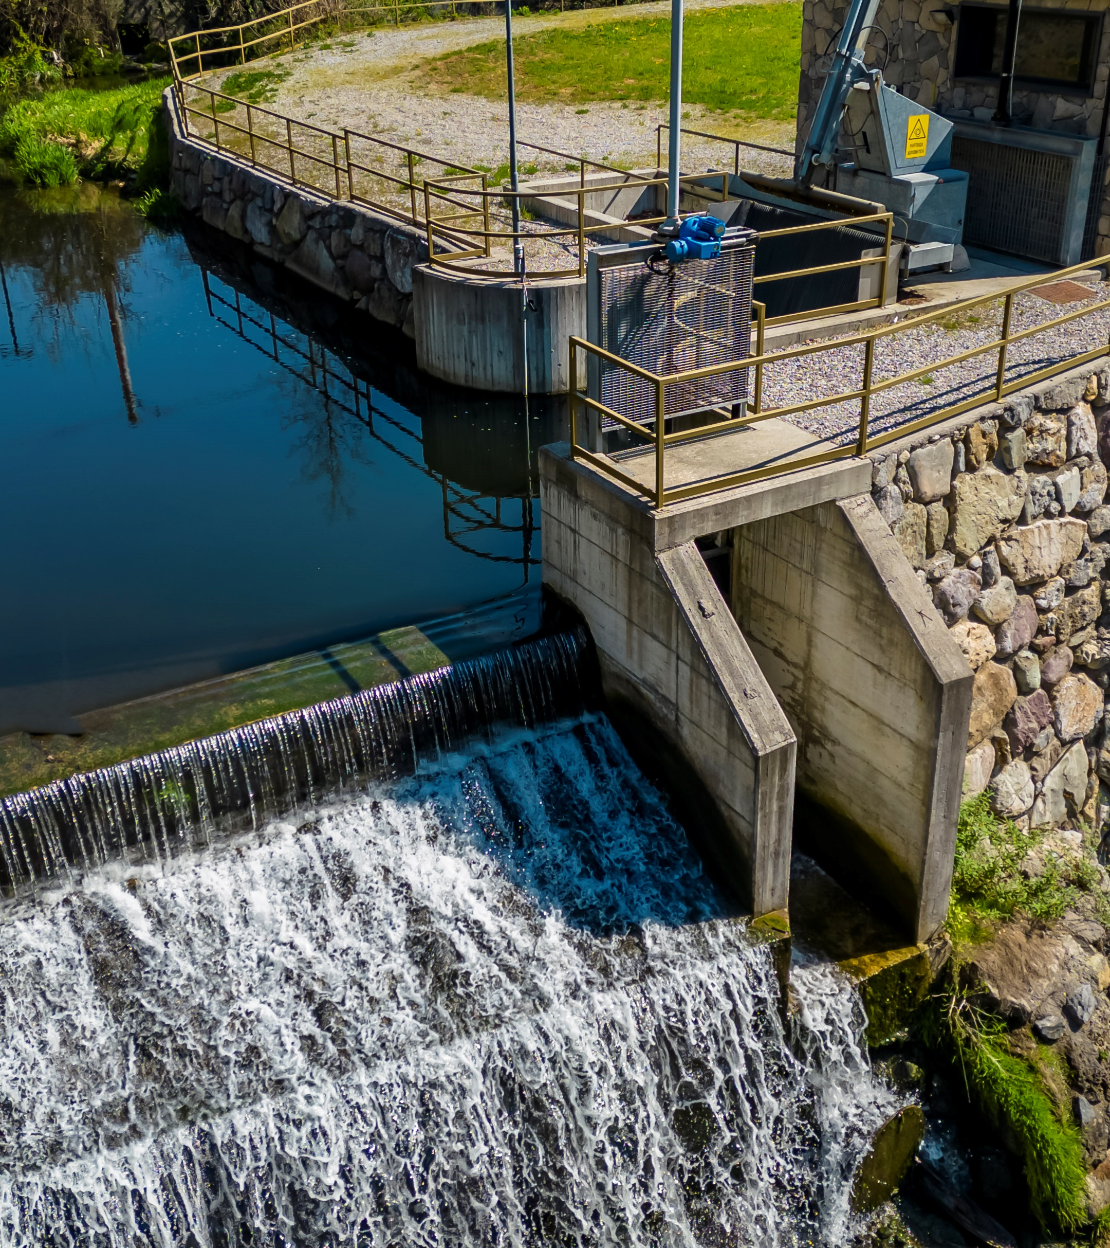
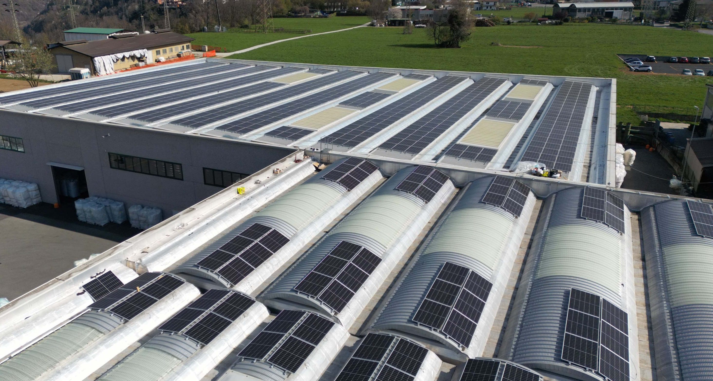
Company divisions
Thermoplastic Powders
Polyethylene Bags
Renewable energy

Slide 4
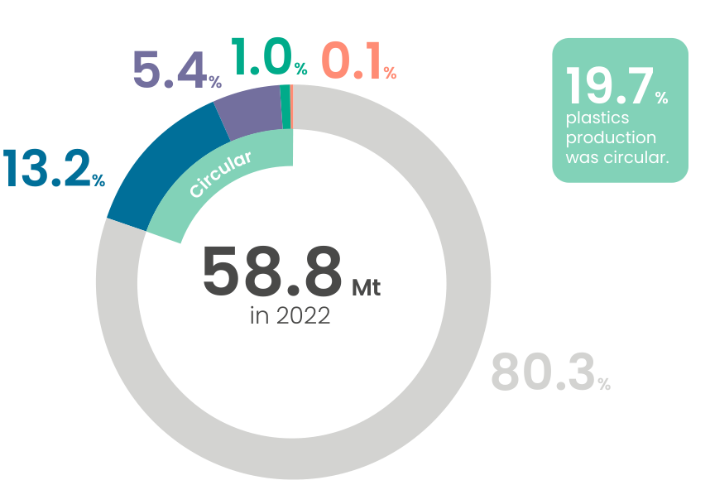
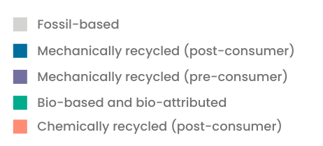
European circular plastics production
In 2022, European production of circular plastics
reached 11.7 Mt. This accounted for 19.7% of European
plastics production in 2022.
Source: THE CIRCULAR ECONOMY FOR PLASTICS - A EUROPEAN ANALYSIS | 2024

Slide 5
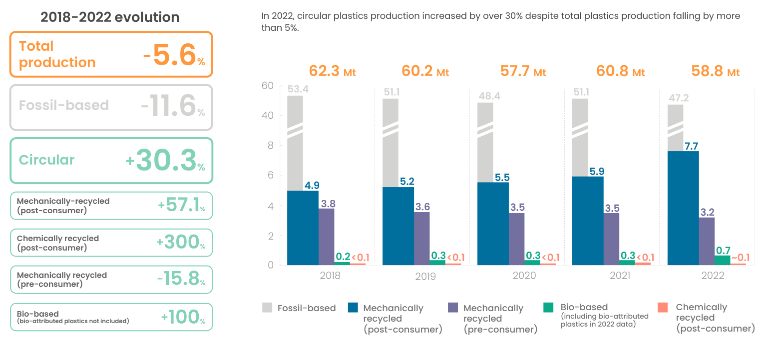
European plastics production evolution
Source: THE CIRCULAR ECONOMY FOR PLASTICS - A EUROPEAN ANALYSIS | 2024

Slide 6
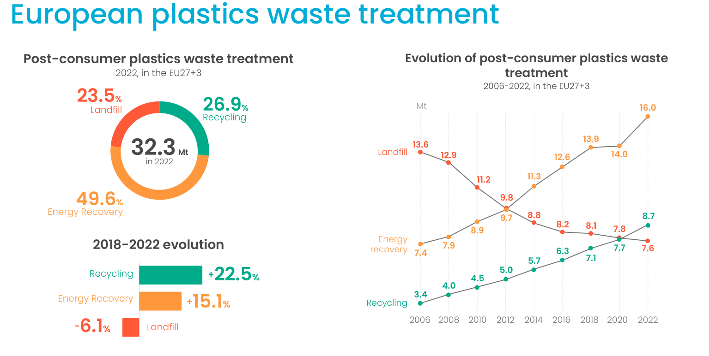
European plastics waste treatment
Source: THE CIRCULAR ECONOMY FOR PLASTICS - A EUROPEAN ANALYSIS | 2024

Slide 7


Post-consumer recycled source in
Poliplast eco powders
LLDPE
from rotational molding
PE
from other molding process

Slide 8
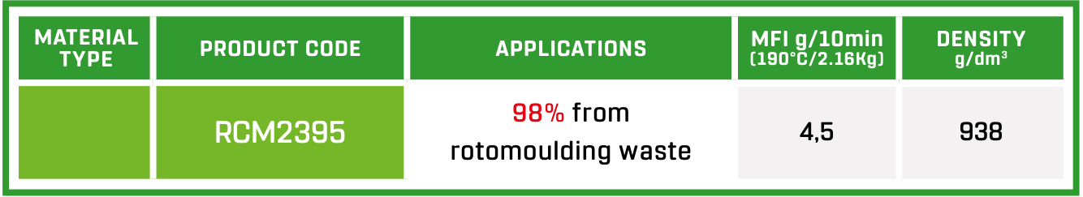
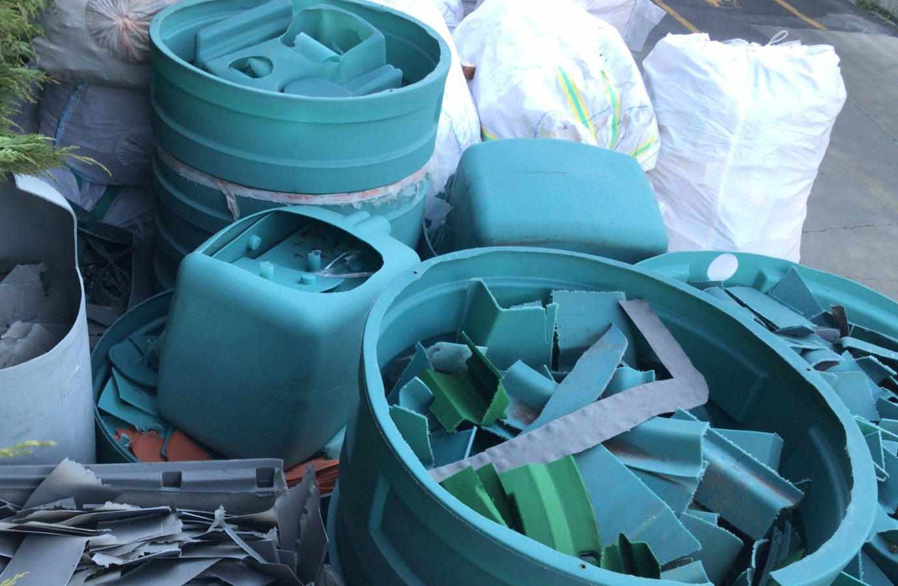
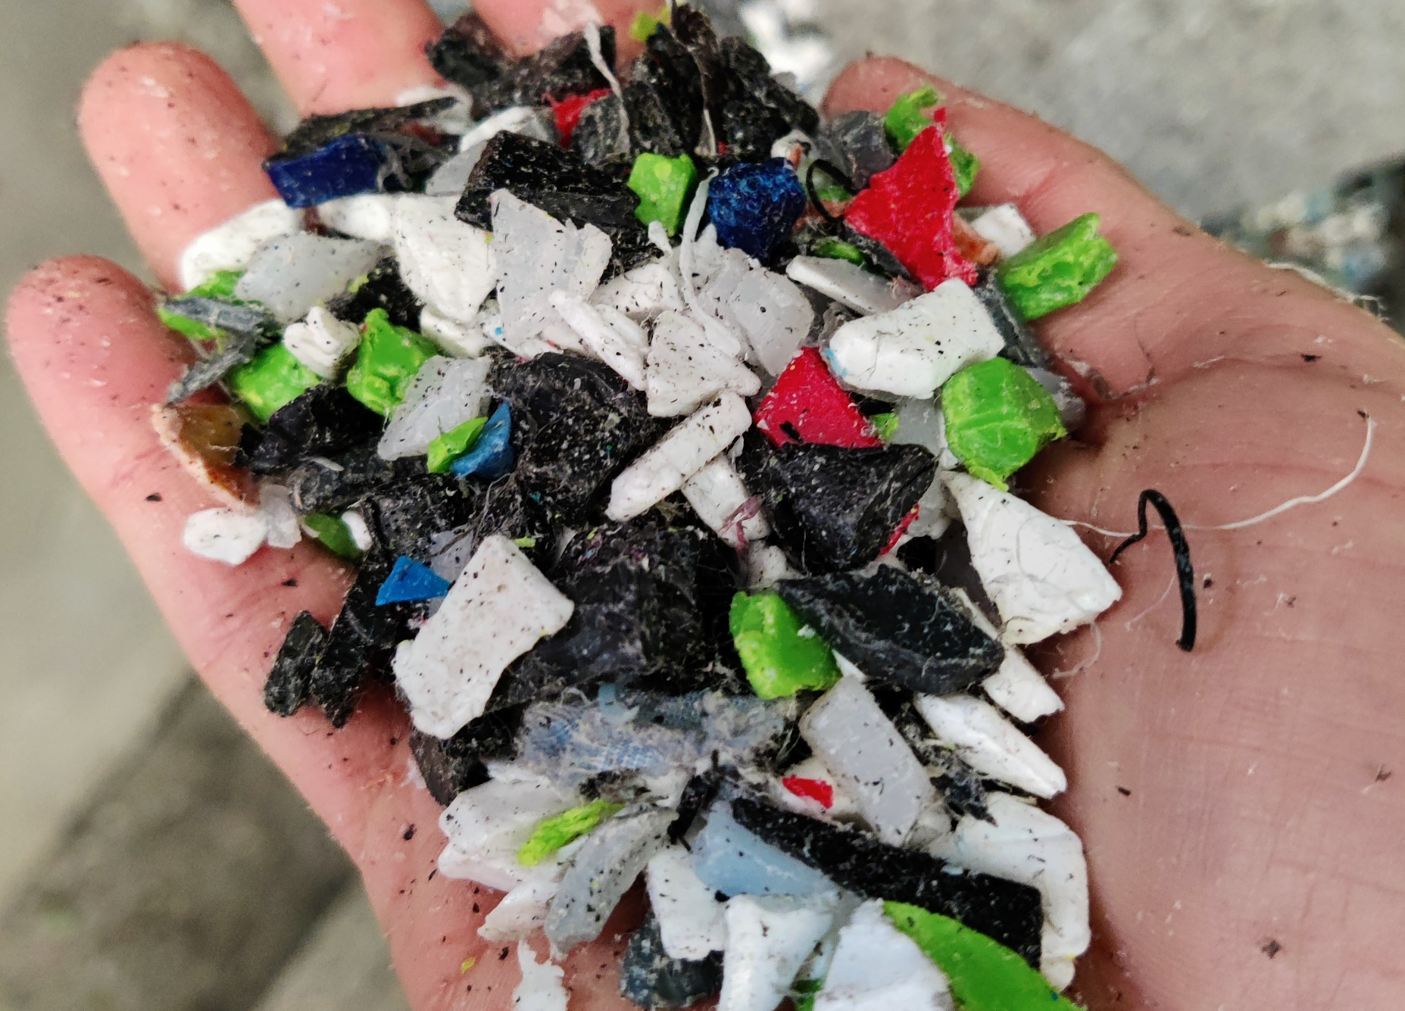
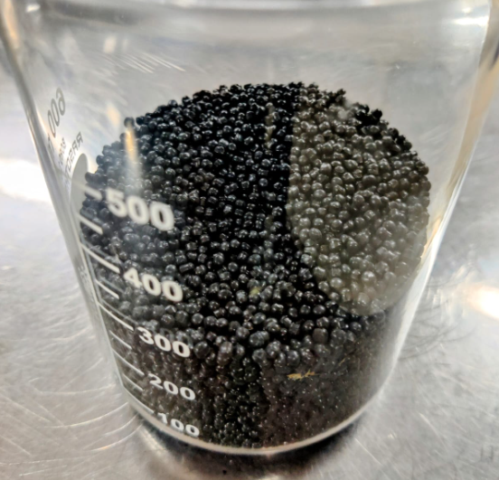
Rotomoulding recycled PE
98% RECYCLED MATERIAL
SOURCE
rotomoulding waste
rotomoulding scrap
grinding
extrusion and filtration

Slide 9
Rotomoulding recycled PE
98% RECYCLED MATERIAL
high % recycled material
material availability based on customer collection
composed only of rotomoulded PE
limited colors, available mainly in black

Slide 10
New ECO PE
OUR FOCUS:
different source of recycled material
good supply chain
new applications for recycled products
many colors
various % of recycled material
certified products

Slide 11
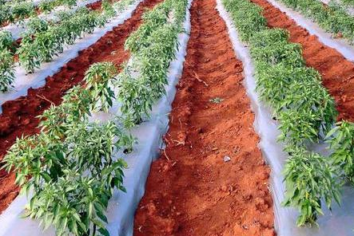
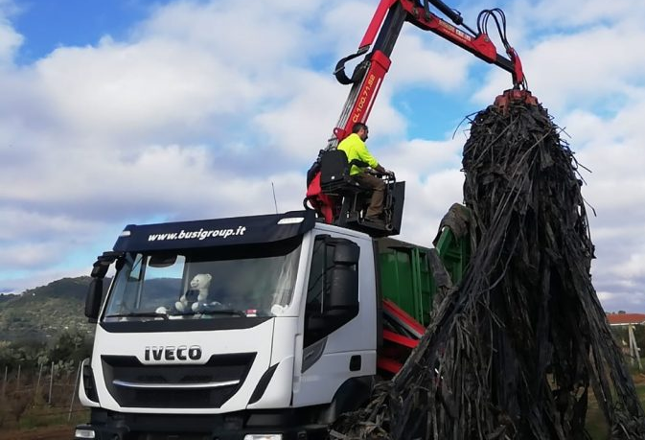


New ECO PE
LLDPE film
waste recovery
Also collected by:

Slide 12
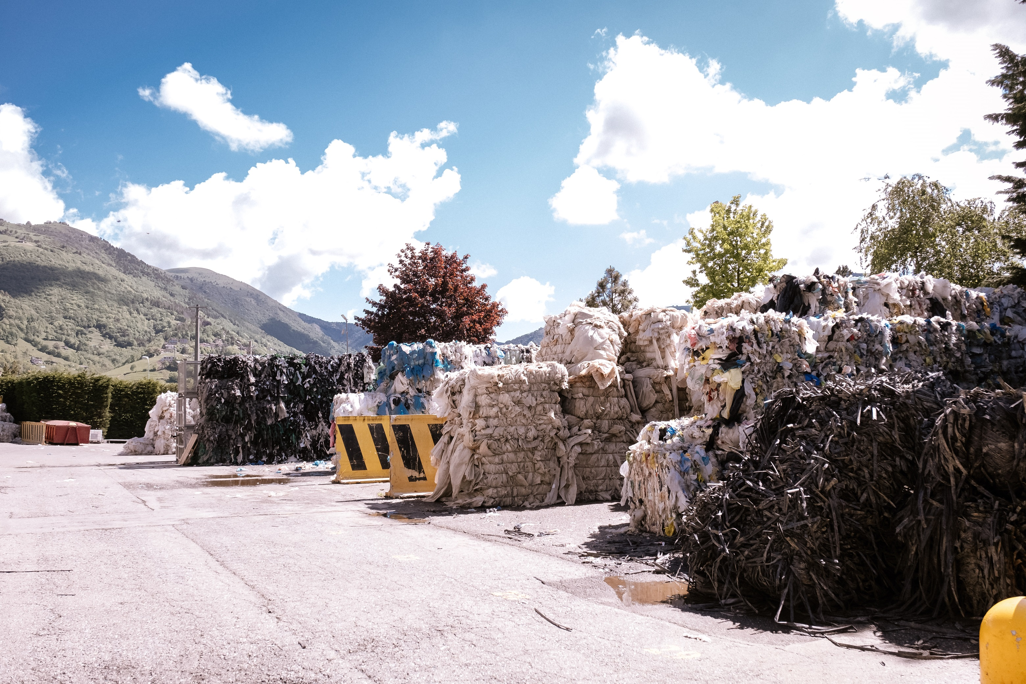
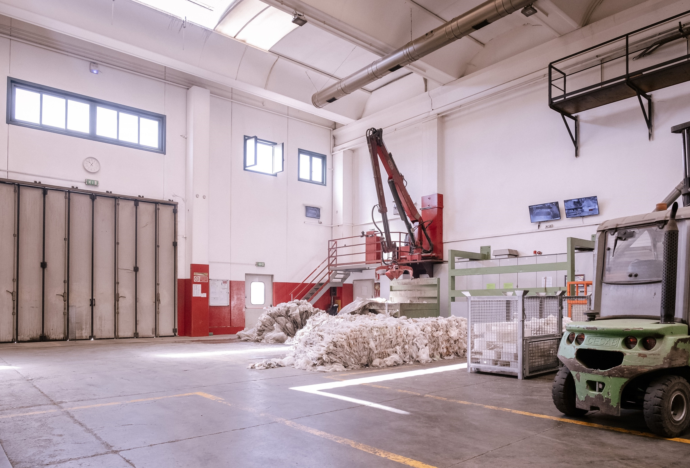
New ECO PE
selection
grinding
separation by color
material selection
reduction into small parts

Slide 13
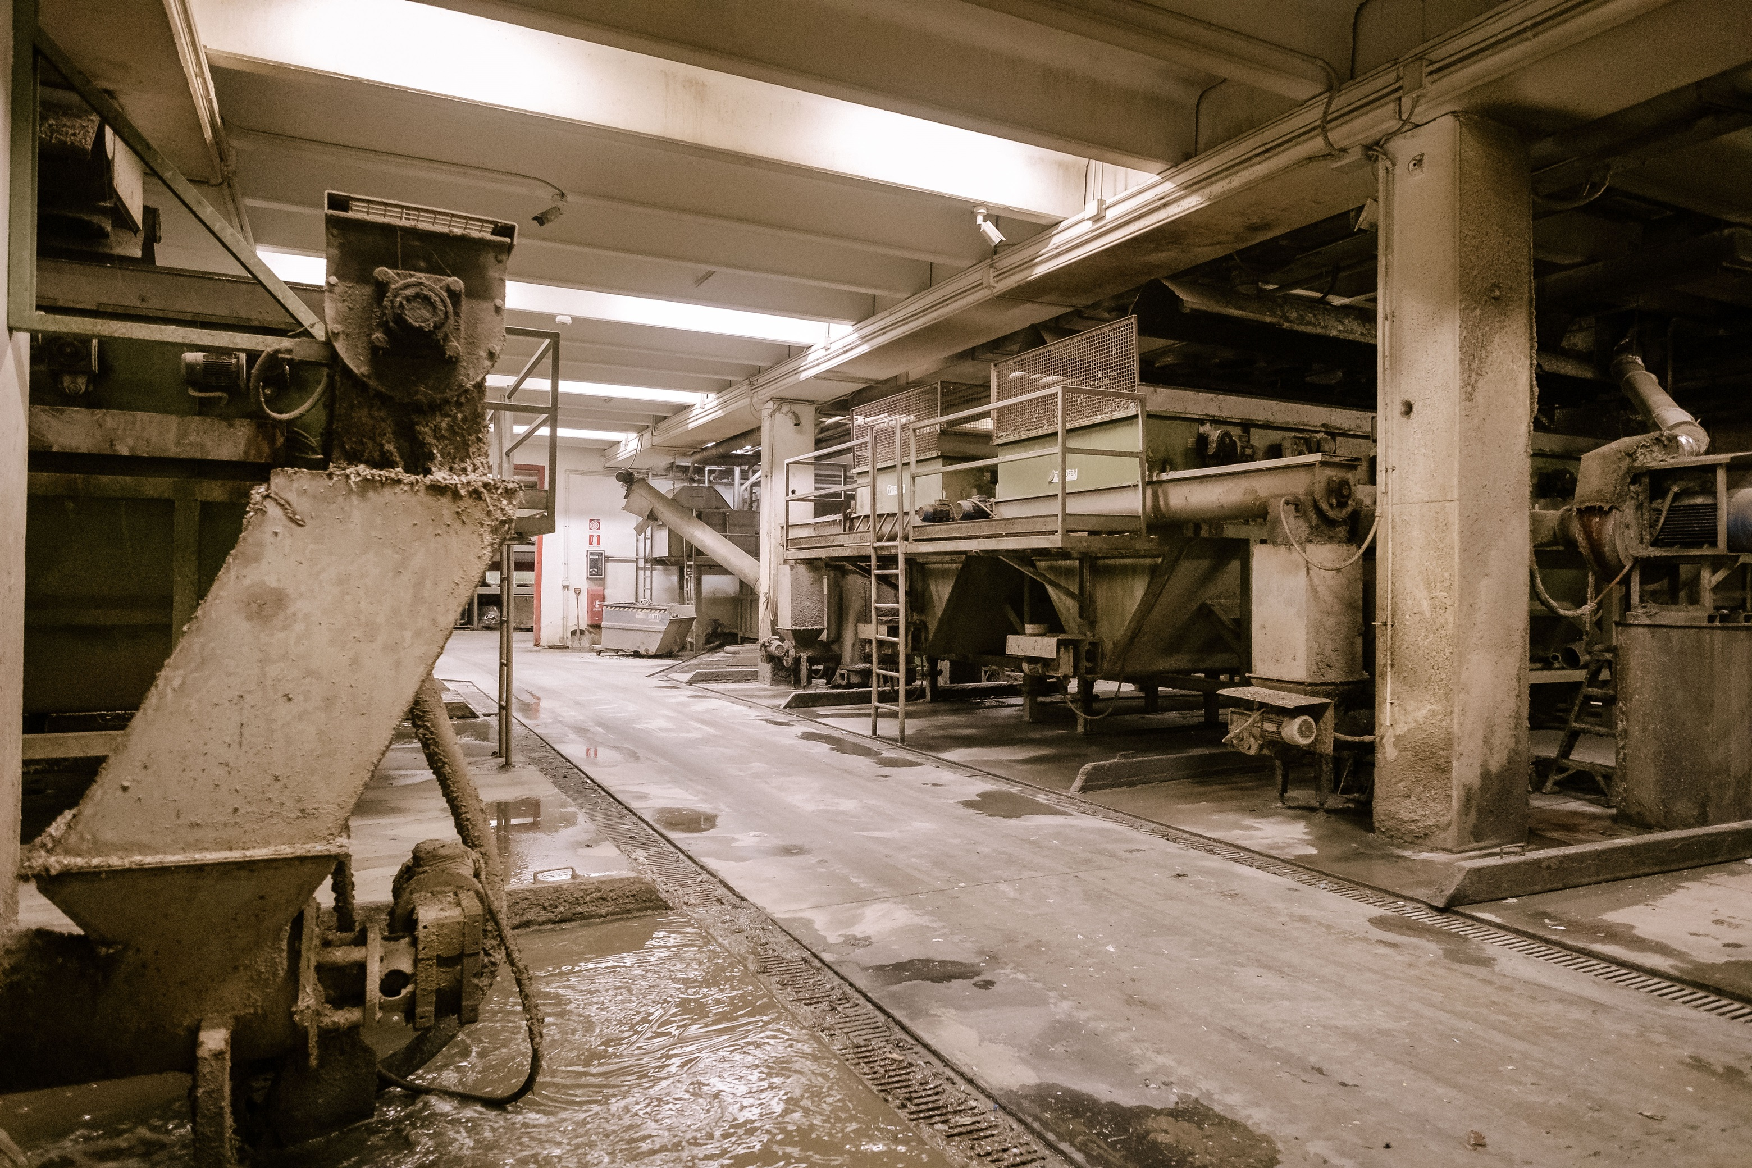
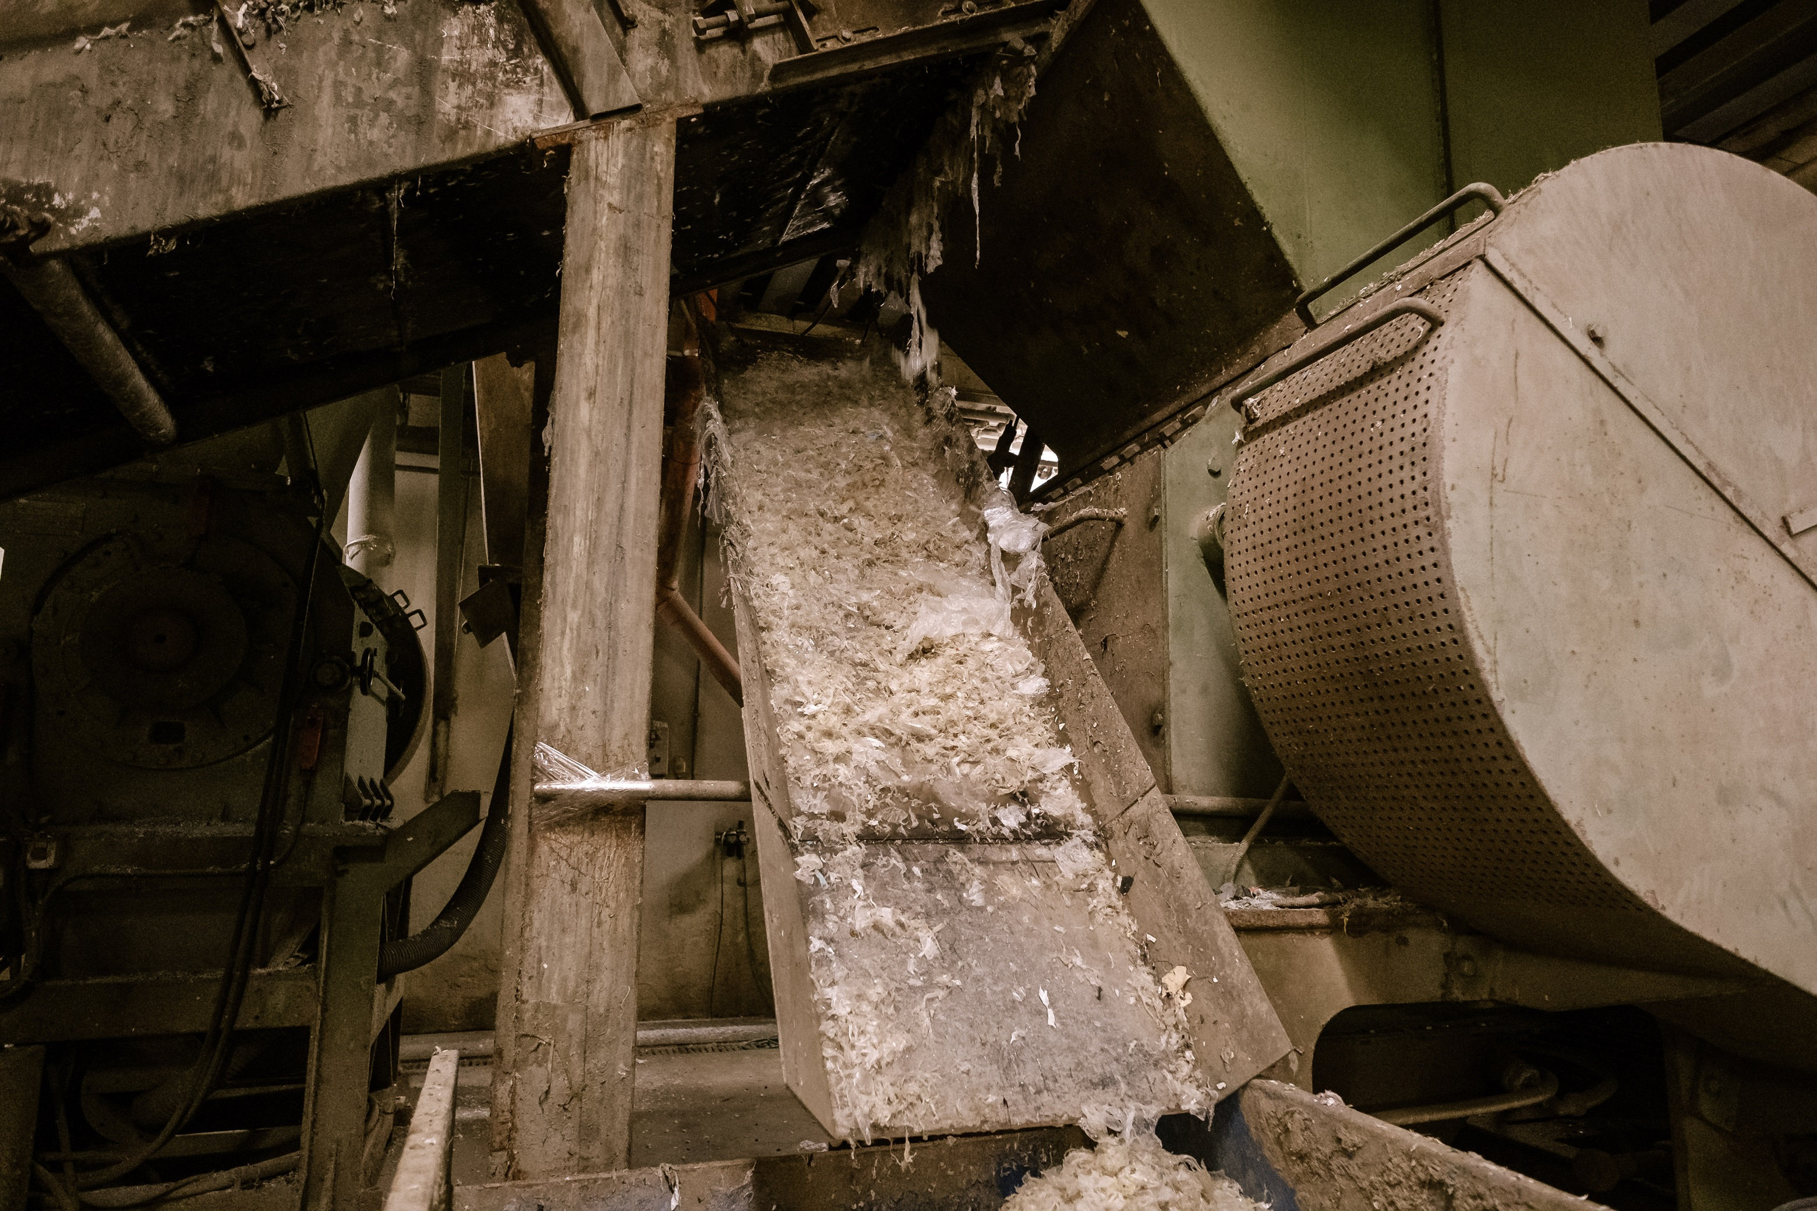
New ECO PE
washing
drying
reduced water consumption
water-purifying plant
minimum humidity for better extrusion process

Slide 14
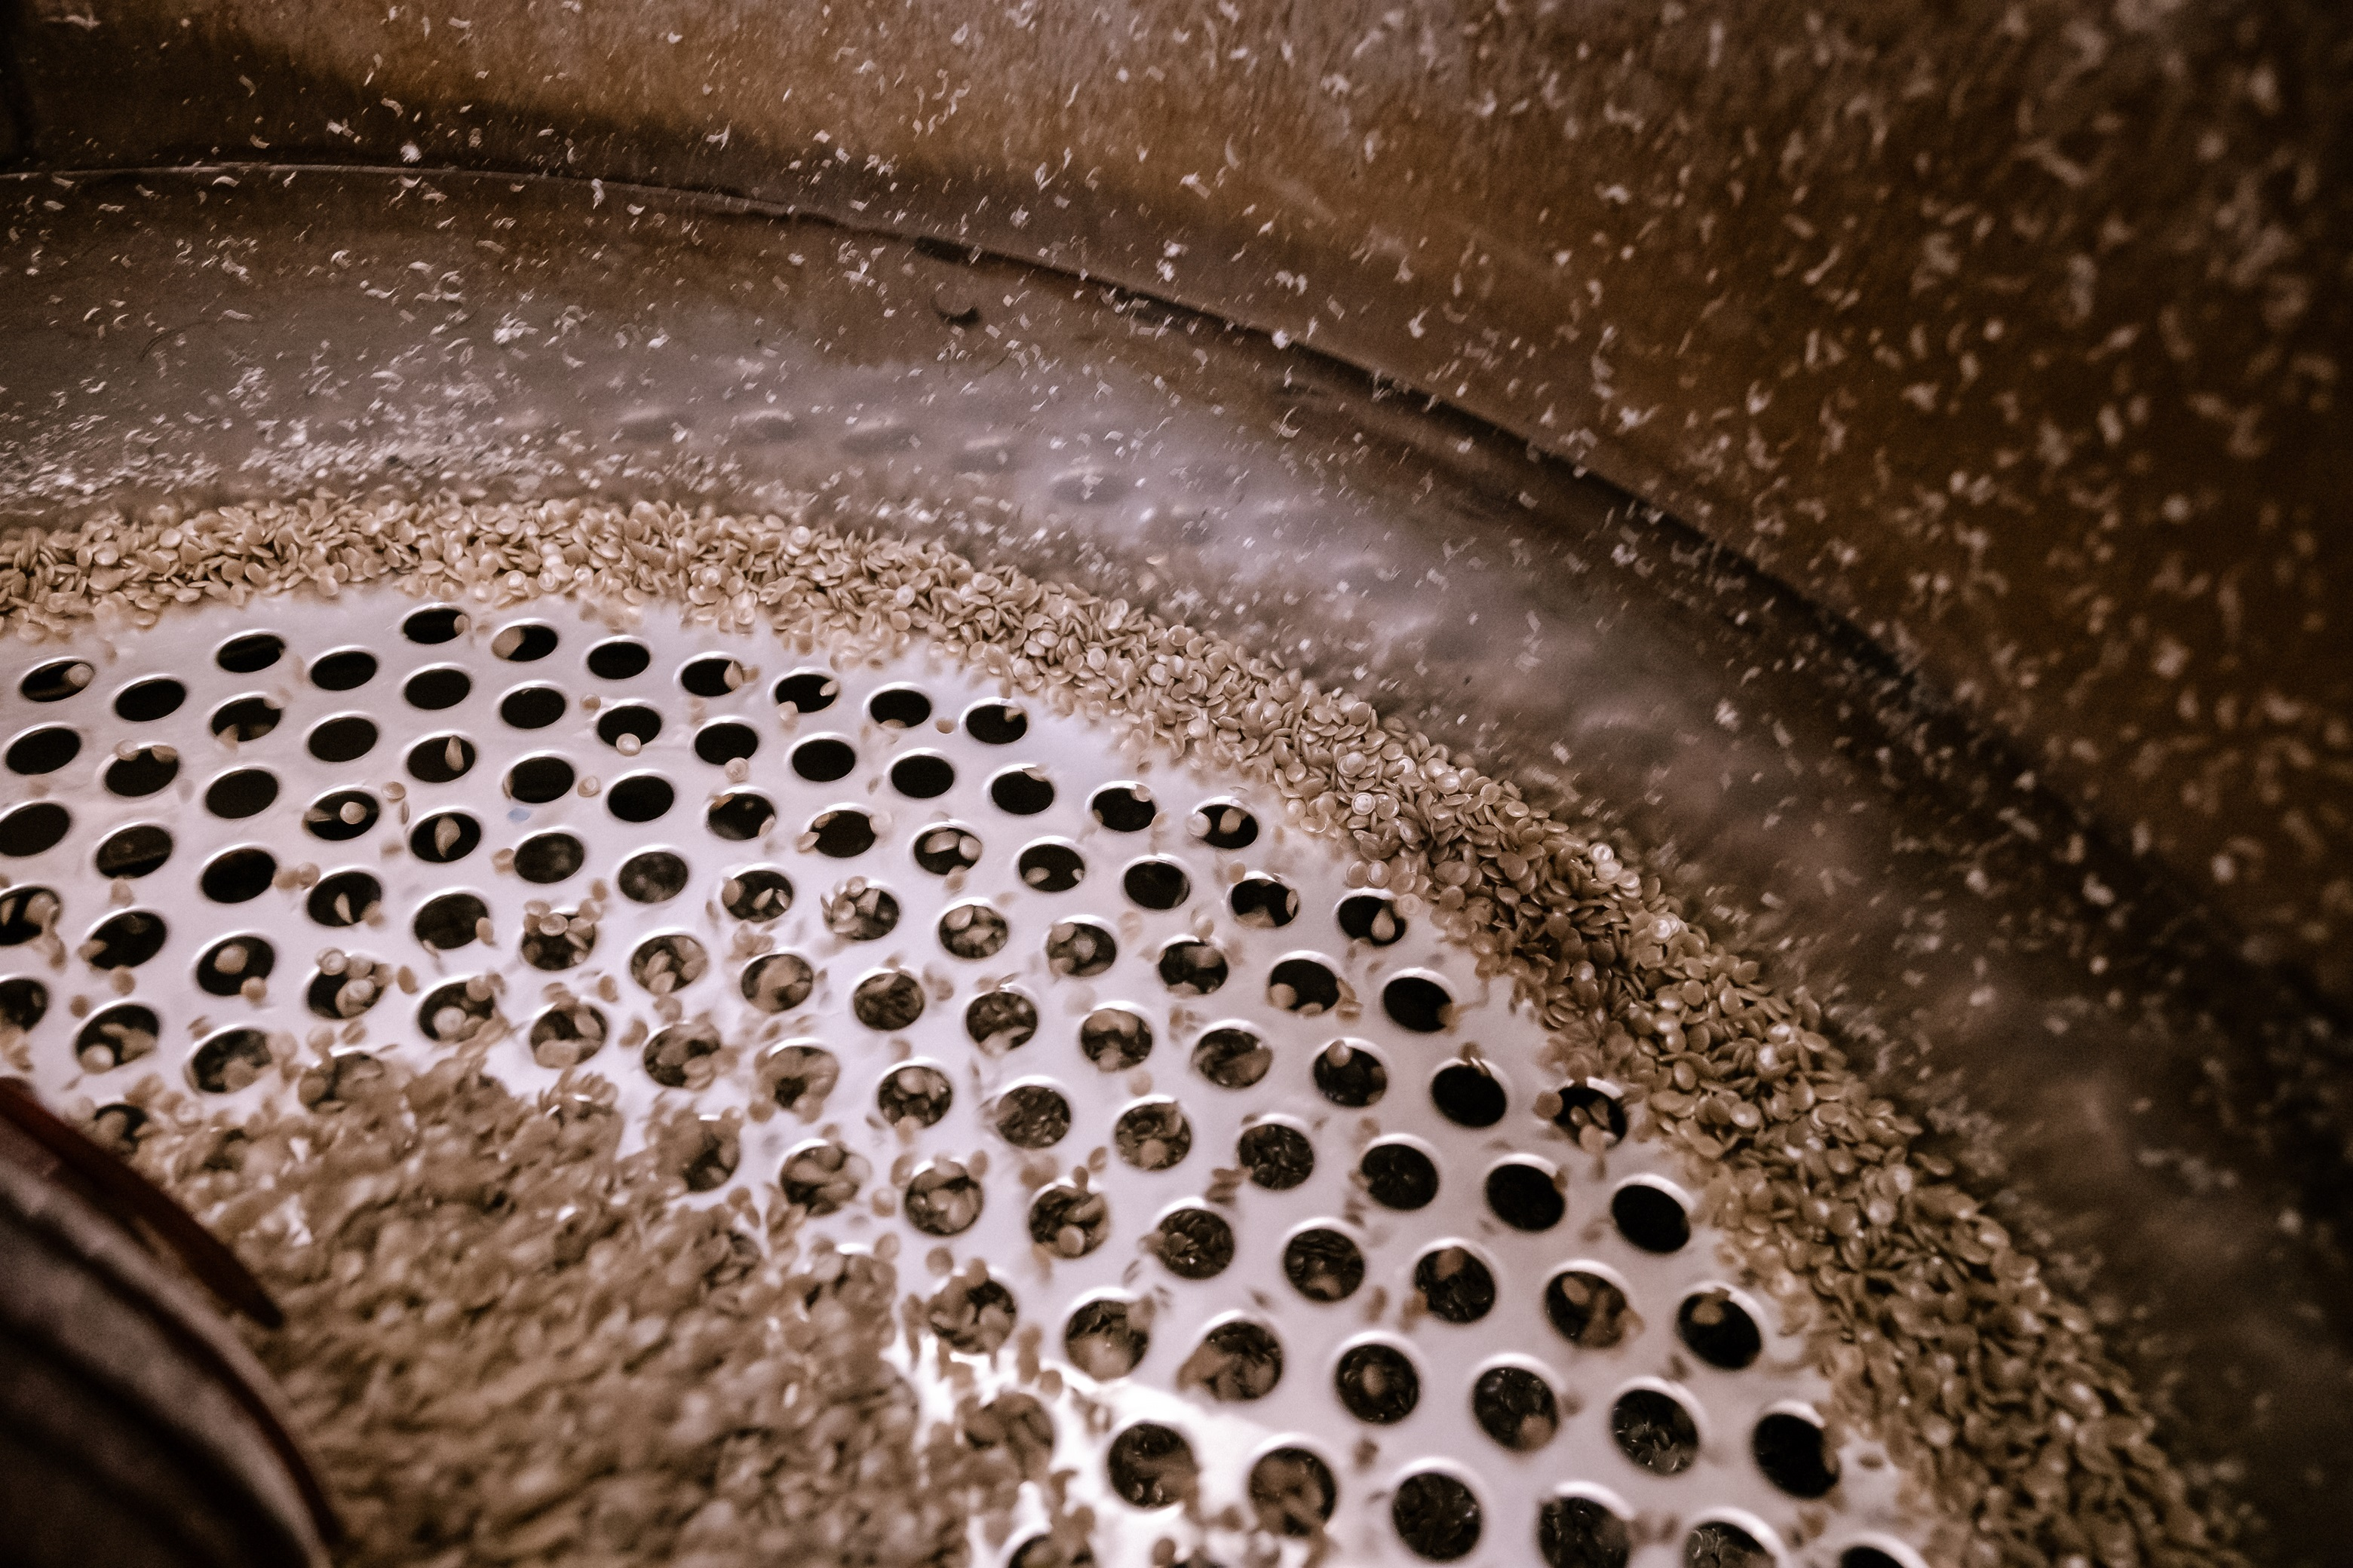
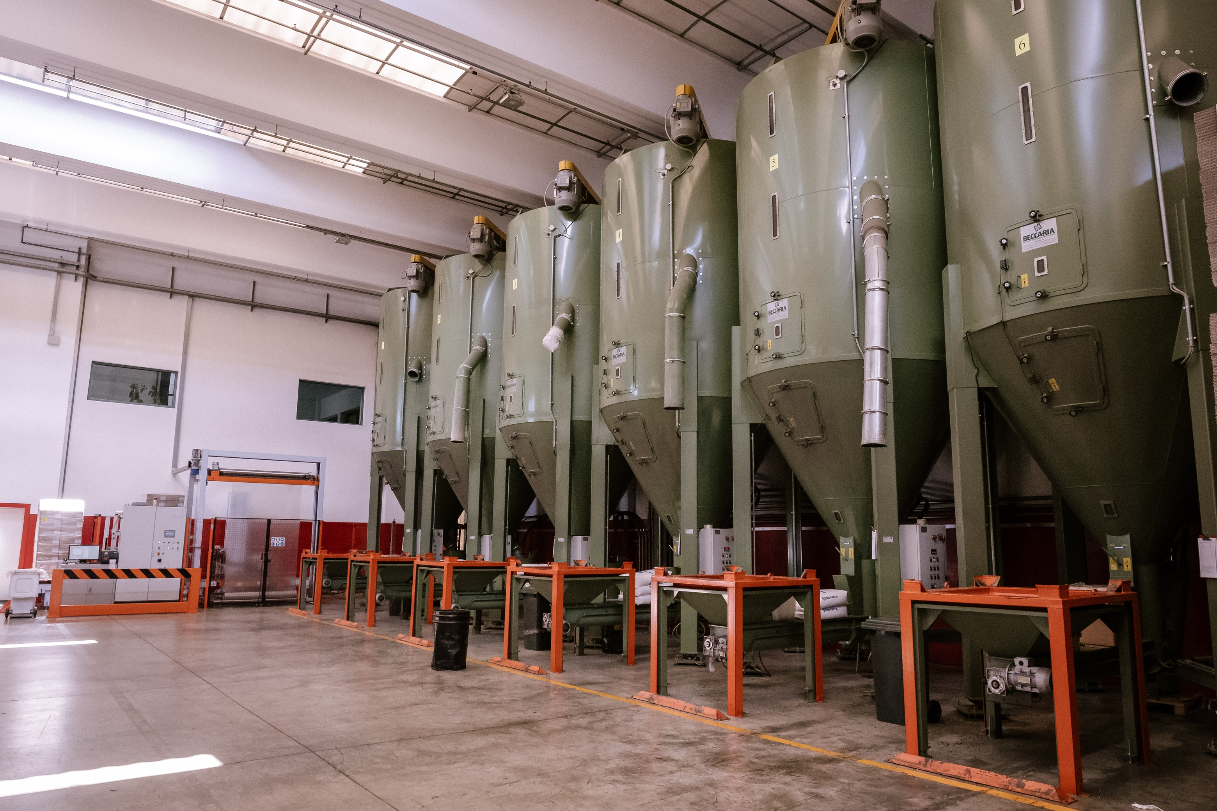
New ECO PE
Extrusion and filtration
granule mixing
melt filtration at 80 microns
homogeneous material
uniform color

Slide 15
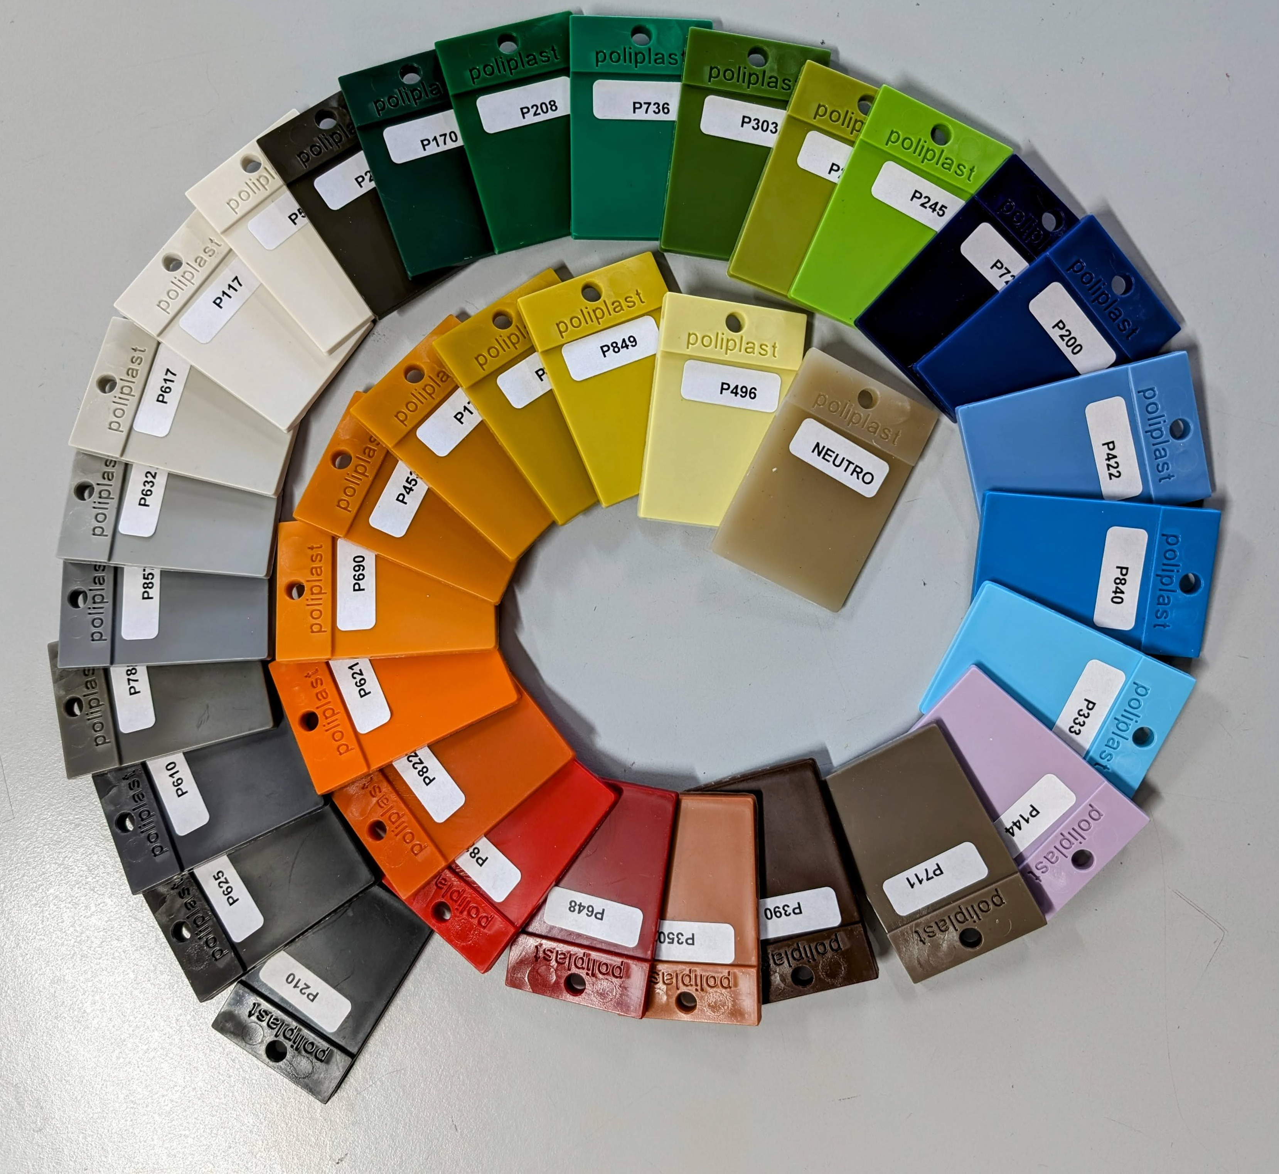
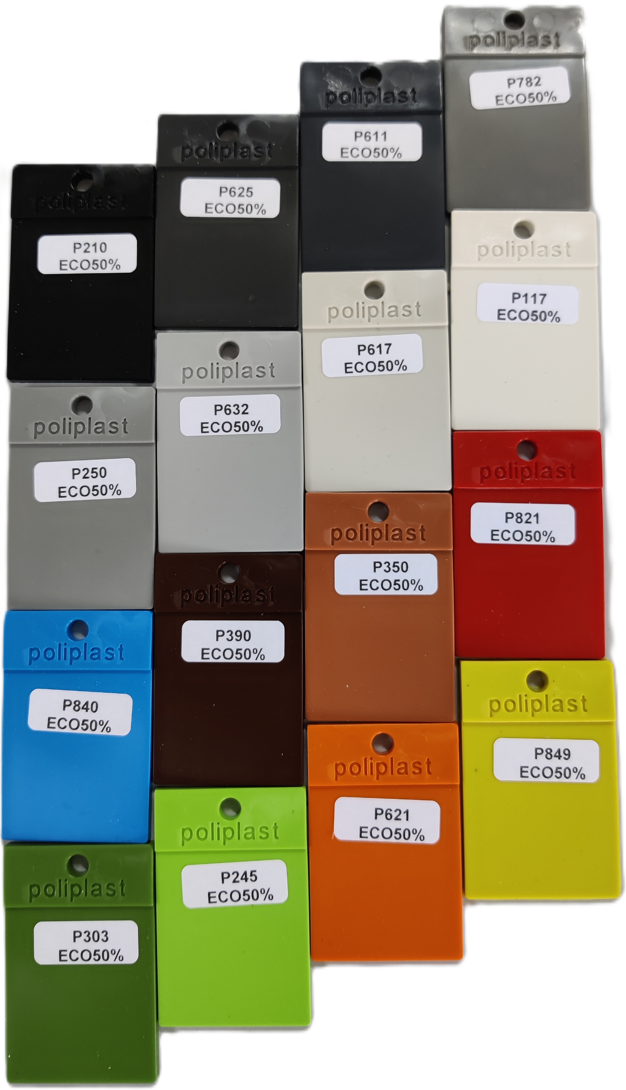

New ECO PE color range
ECO 30%
ECO 50%

Slide 16
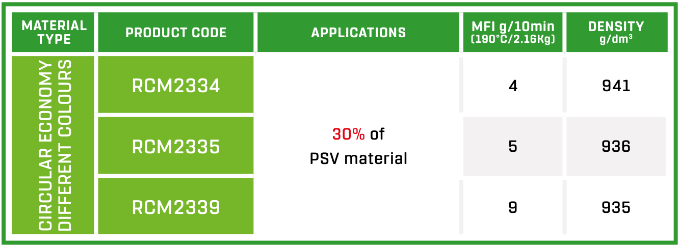
ECO PRODUCTS
CERTIFIED,PLASTICA SECONDA VITA
30% RECYCLED MATERIAL
high density grade
with greater flexural modulus
medium density and medium mfi
for general use
medium density and high mfi
better mouldability

Slide 17
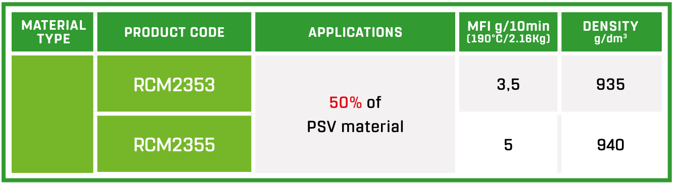
ECO PRODUCTS
CERTIFIED,PLASTICA SECONDA VITA
50% RECYCLED MATERIAL
low mfi
medium density
high density grade
better mouldability

Slide 18

Certificate ,PLASTICA SECONDA VITA
PSV Mix Eco label: for materials and products
obtained from mixtures of materials obtained from:
separate waste collection and/or industrial residues
having a minimum content of recycled plastics of 30%

Slide 19
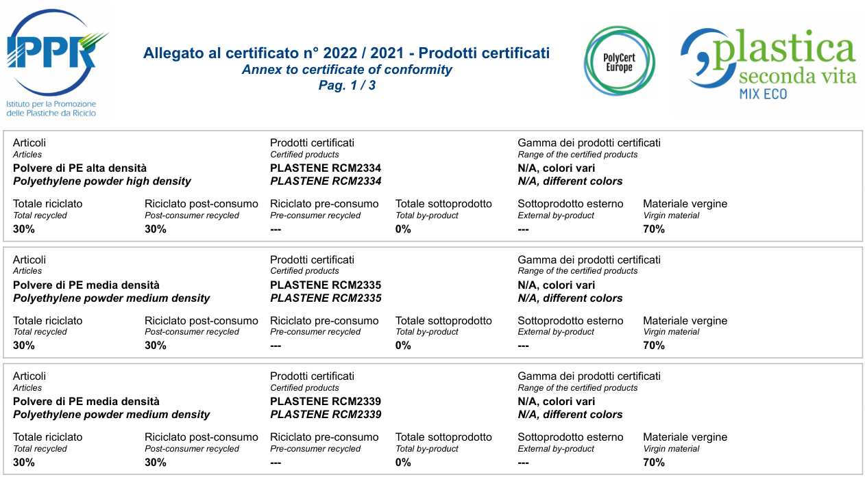
Certificate ,PLASTICA SECONDA VITA

Slide 20
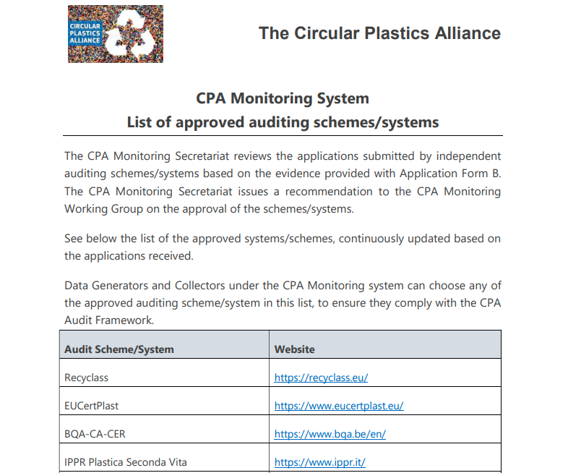
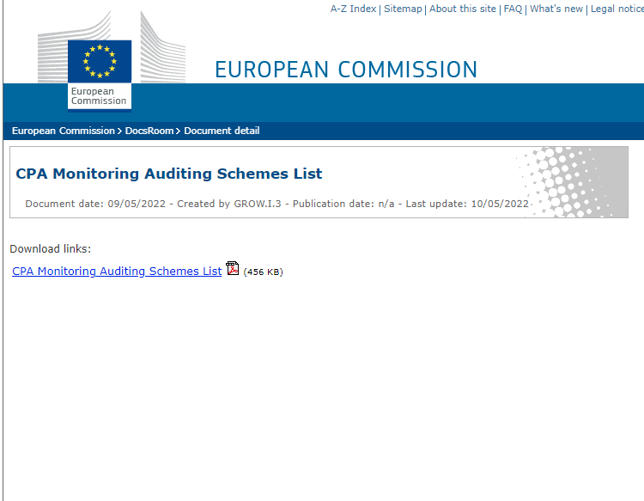
APPROVED by EU COMMISSION

Slide 21
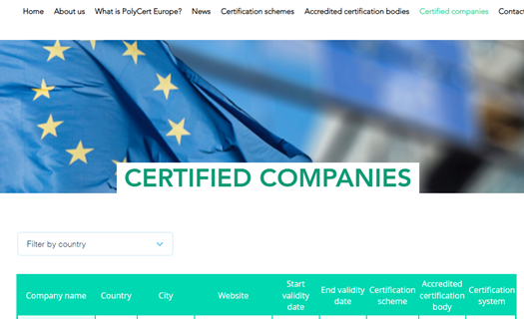

EUROPEAN PLATFORM
PolyCert Europe is an umbrella technical platform harmonising existing certification schemes for converters of polymeric materials in Europe. The objective of PolyCert Europe is to provide quality certification and verification of recycled content in converted products.

Slide 22
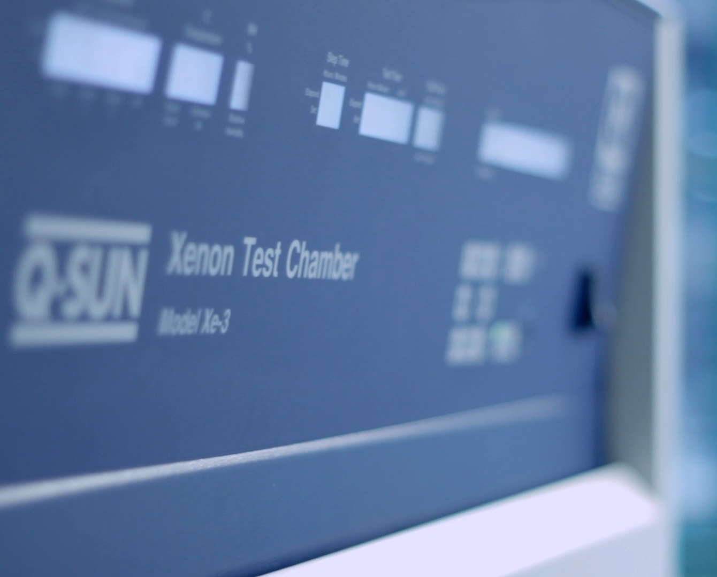
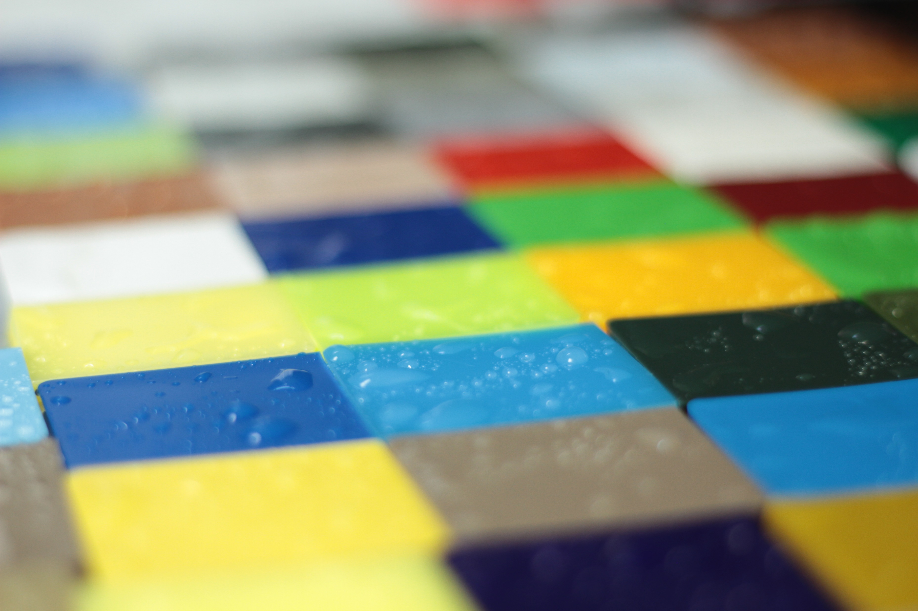
Weathering test – color deviation

Slide 23
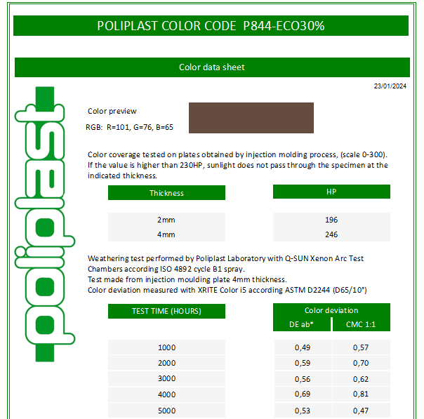
Test for EACH COLOR
Technical data sheet
Rgb values
Coverage 2 and 4mm
Color deviation
2023
start test up to 5000h

Slide 24
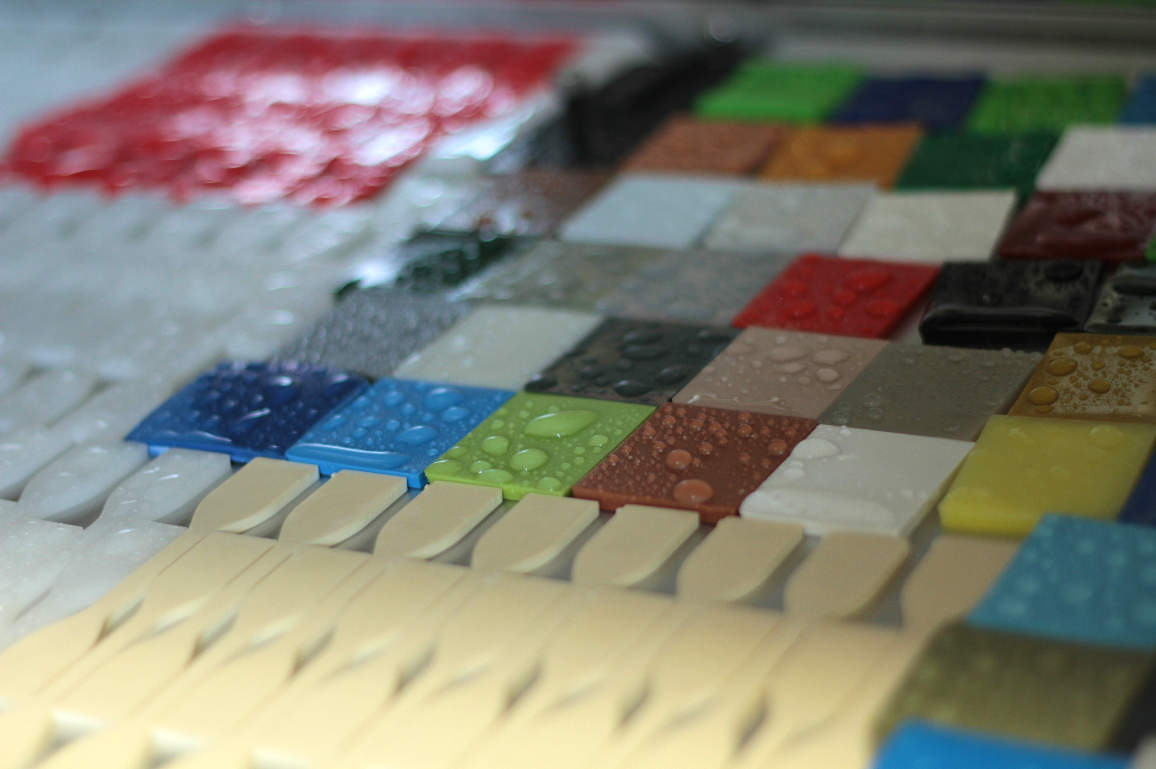
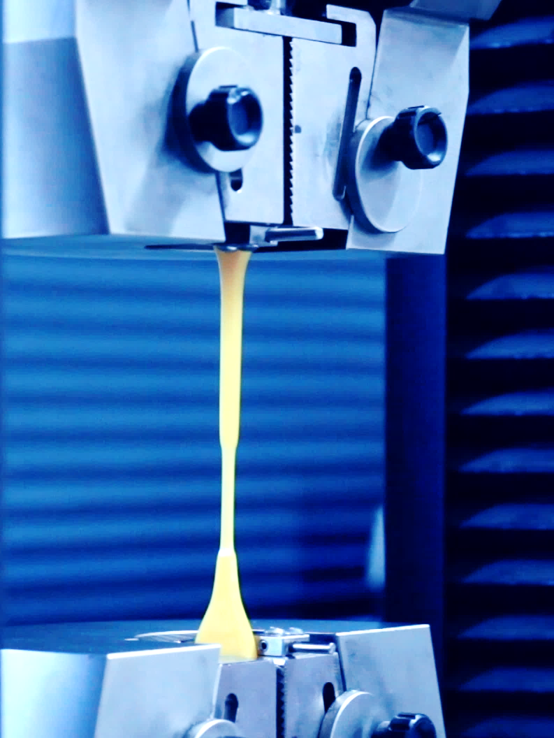
Weathering test – mechanical properties

Slide 25
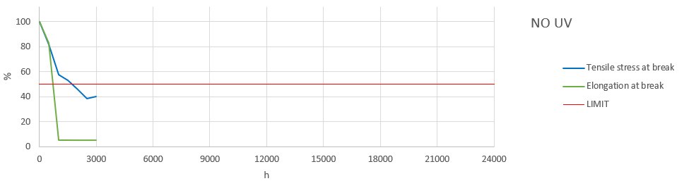
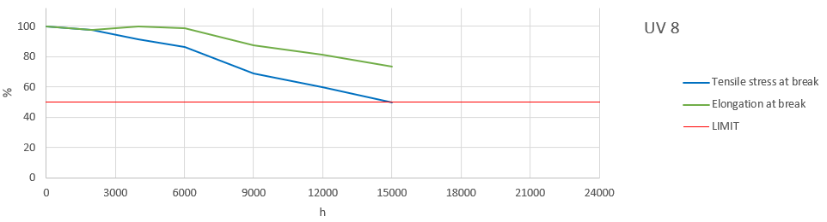
Weathering test – mechanical properties

Slide 26
Thanks for the attention

