Slide 1


Rotopol VIII conference 2024

Slide 2
Hybrid machines and
Low fuel consumption with low emissions

Slide 3

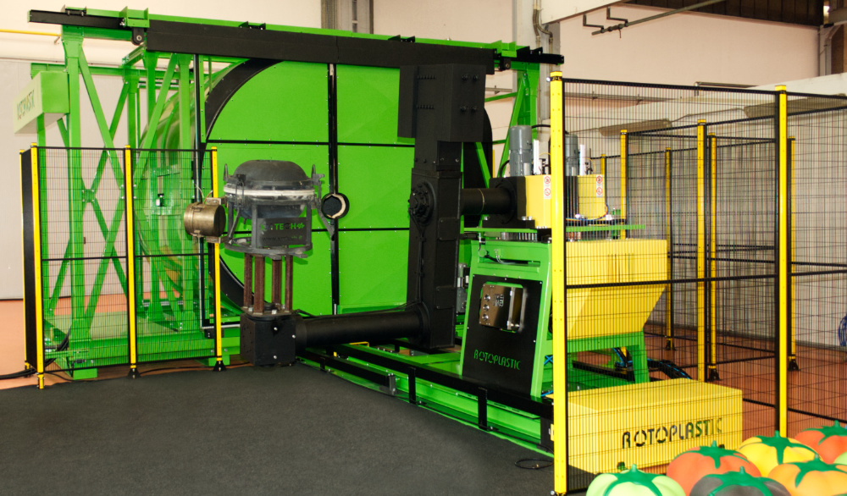
HYBRID MACHINE

Slide 4

Rotoplastic Hybrid machine it’s HERE
After 2 years of research and development Rotoplastic in April 2023 presents the first Hybrid machine with open heating exchanger and with natural GAS both electric heating system. It’s time to release data about consumption:
18:00 Oven time
265 °C K-Paq peak oven temperature
250 °C Oven Setpoint
128 °C Oven internal temperature reached
155 °C Final internal temperature reached
1,7 m3 total gas consumption
22,0 Kw/h (total of machine)
5,6 m3/h

Slide 5
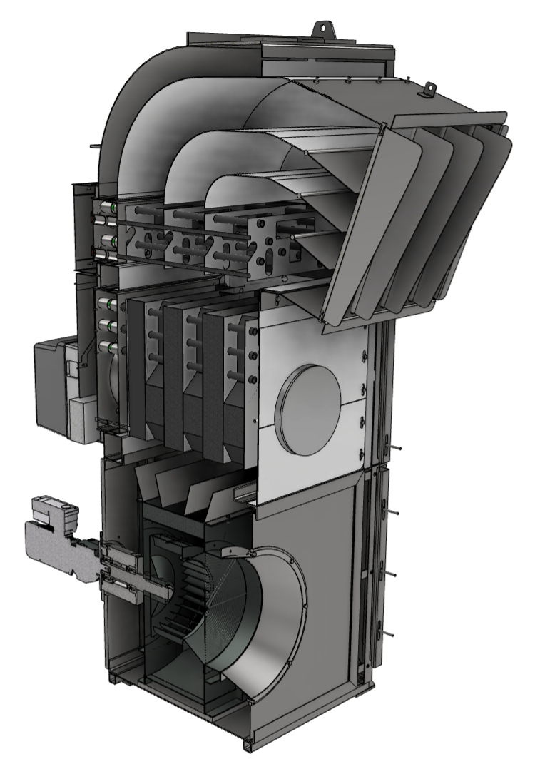
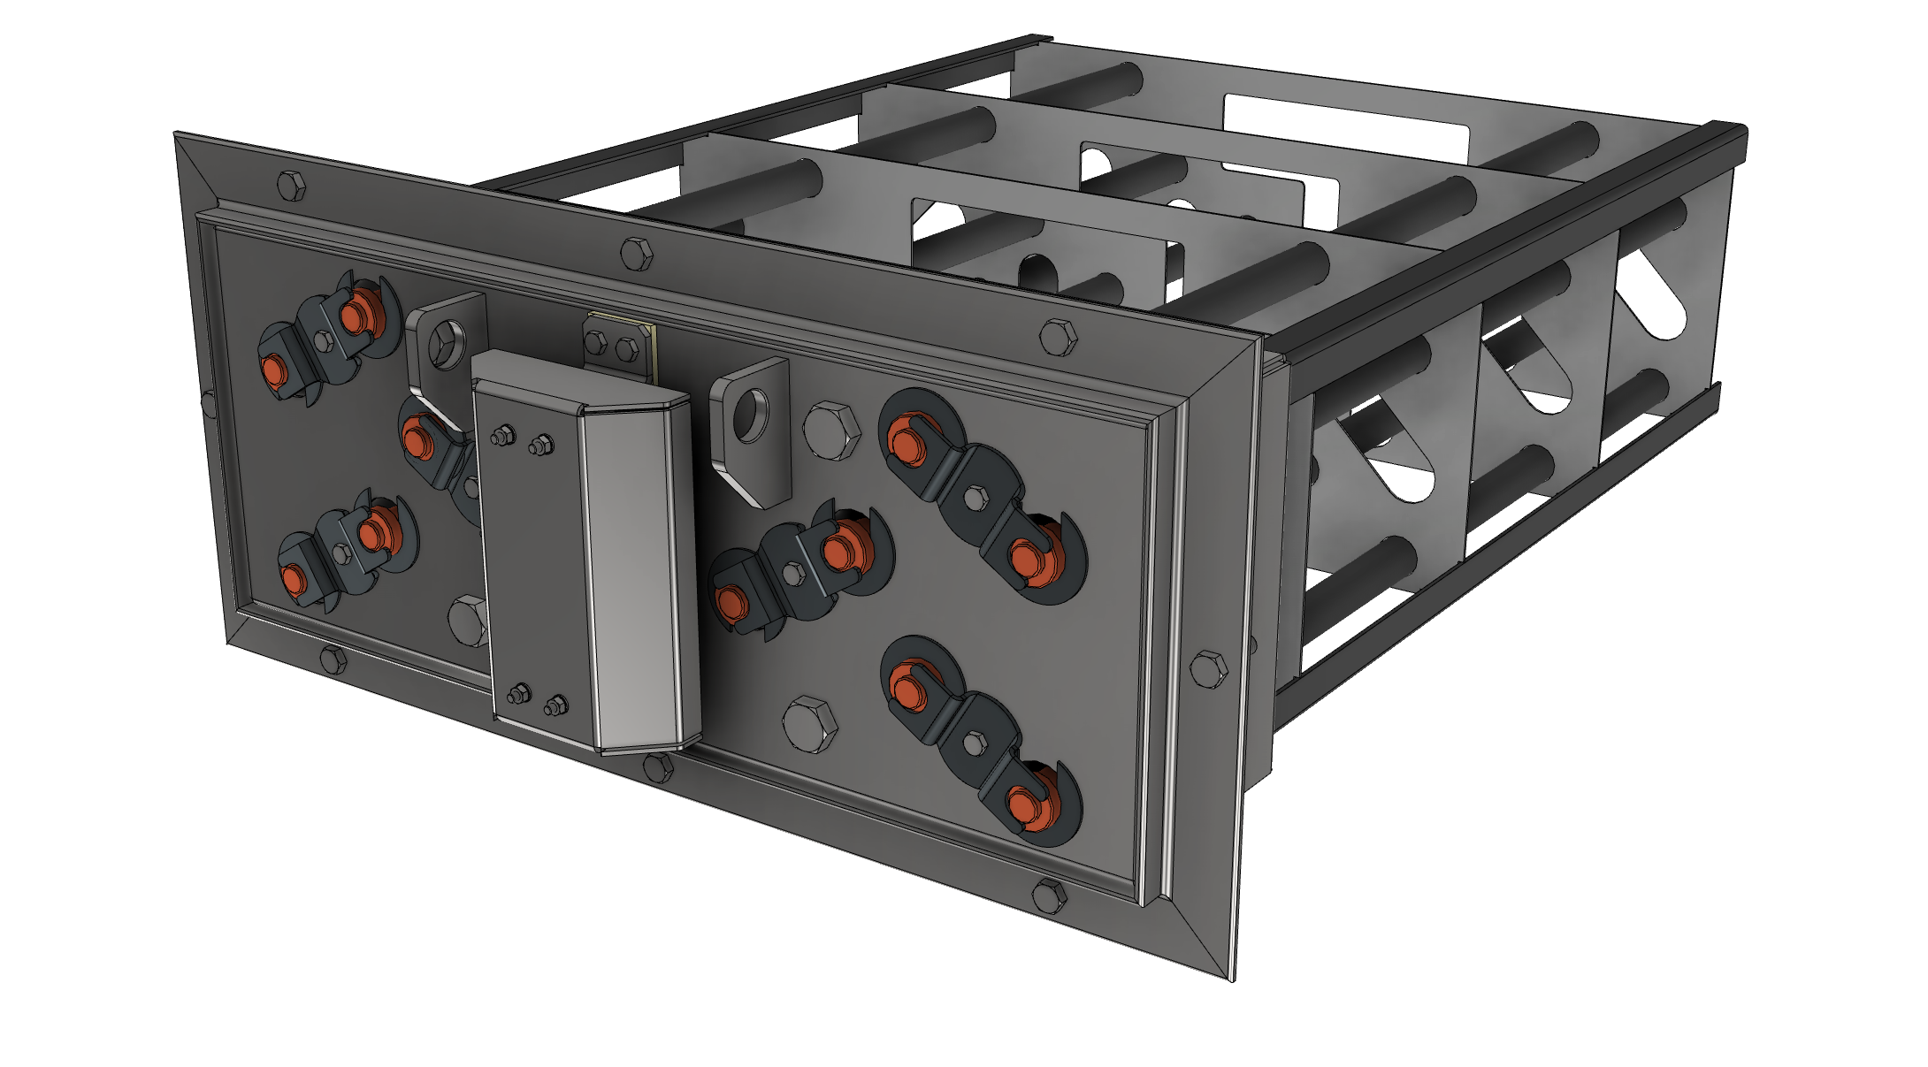
How works
COMPACT HEATING CHAMBER
ROTOPLASTIC HPM
HYBRID POWER MODULE
ELECTRIC HEATING
GAS HEATING
HOT AIR
LOW CONSUMPTION FAN
COLD AIR

Slide 6
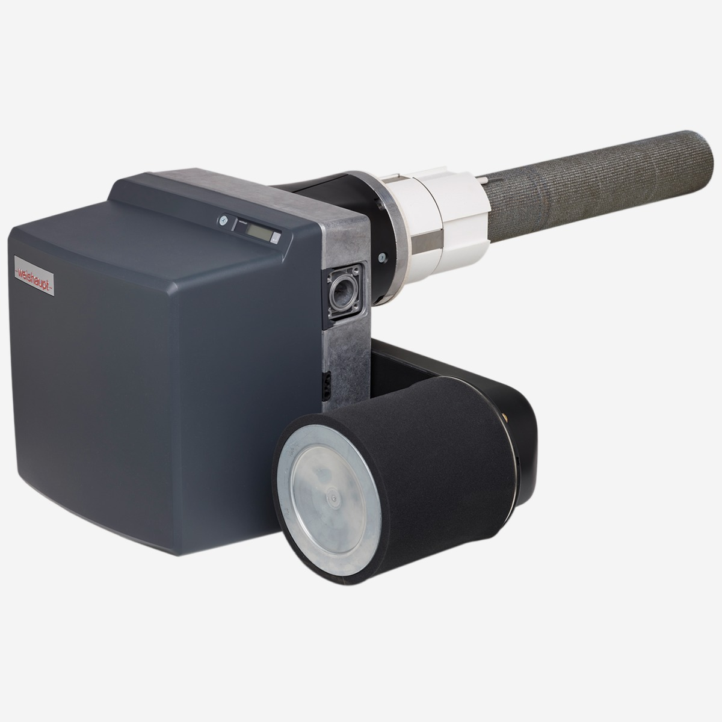

Revolution with new burners Ultra LowNOx
Efficient and low emission.
PLN stands for Premix Low Nox, a system that combines premixing with surface-stabilized combustion. This guarantees an homogeneous gas-air mixture and reliable ignition behaviour
Low emissions Meet NOx emission limits all around the world
High efficiency Permanent magnet synchronous motor, complete with VSD (meets IE5 standards)

Slide 7
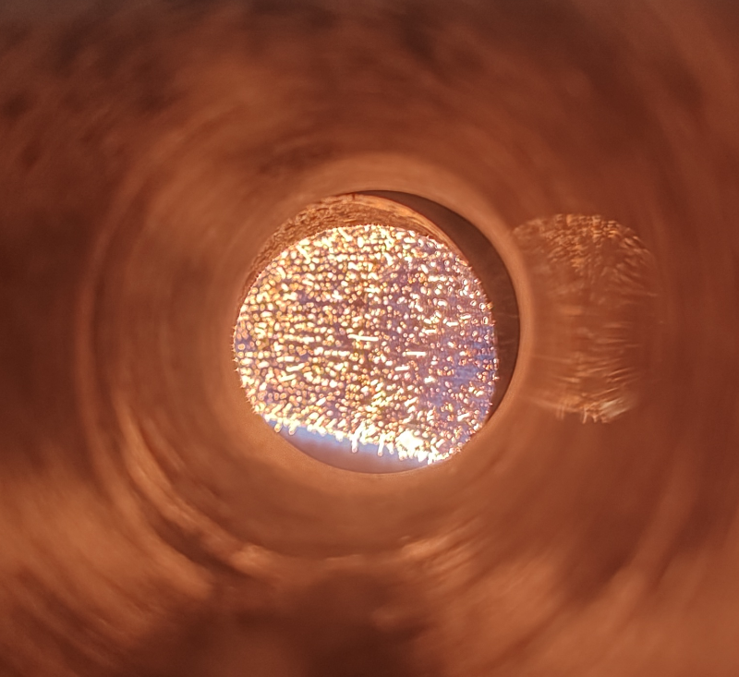
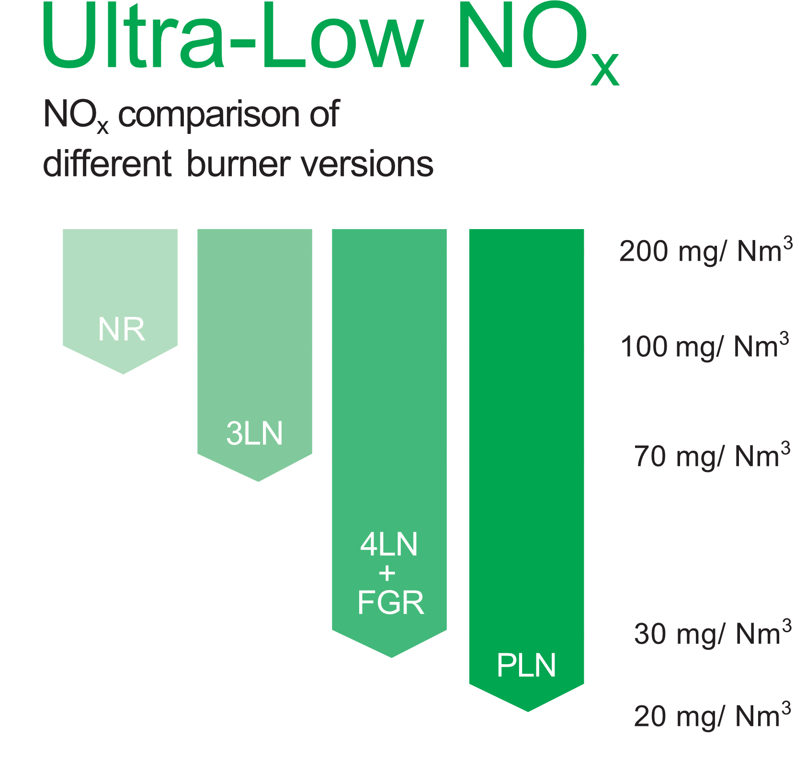
PLN FLAME

Slide 8
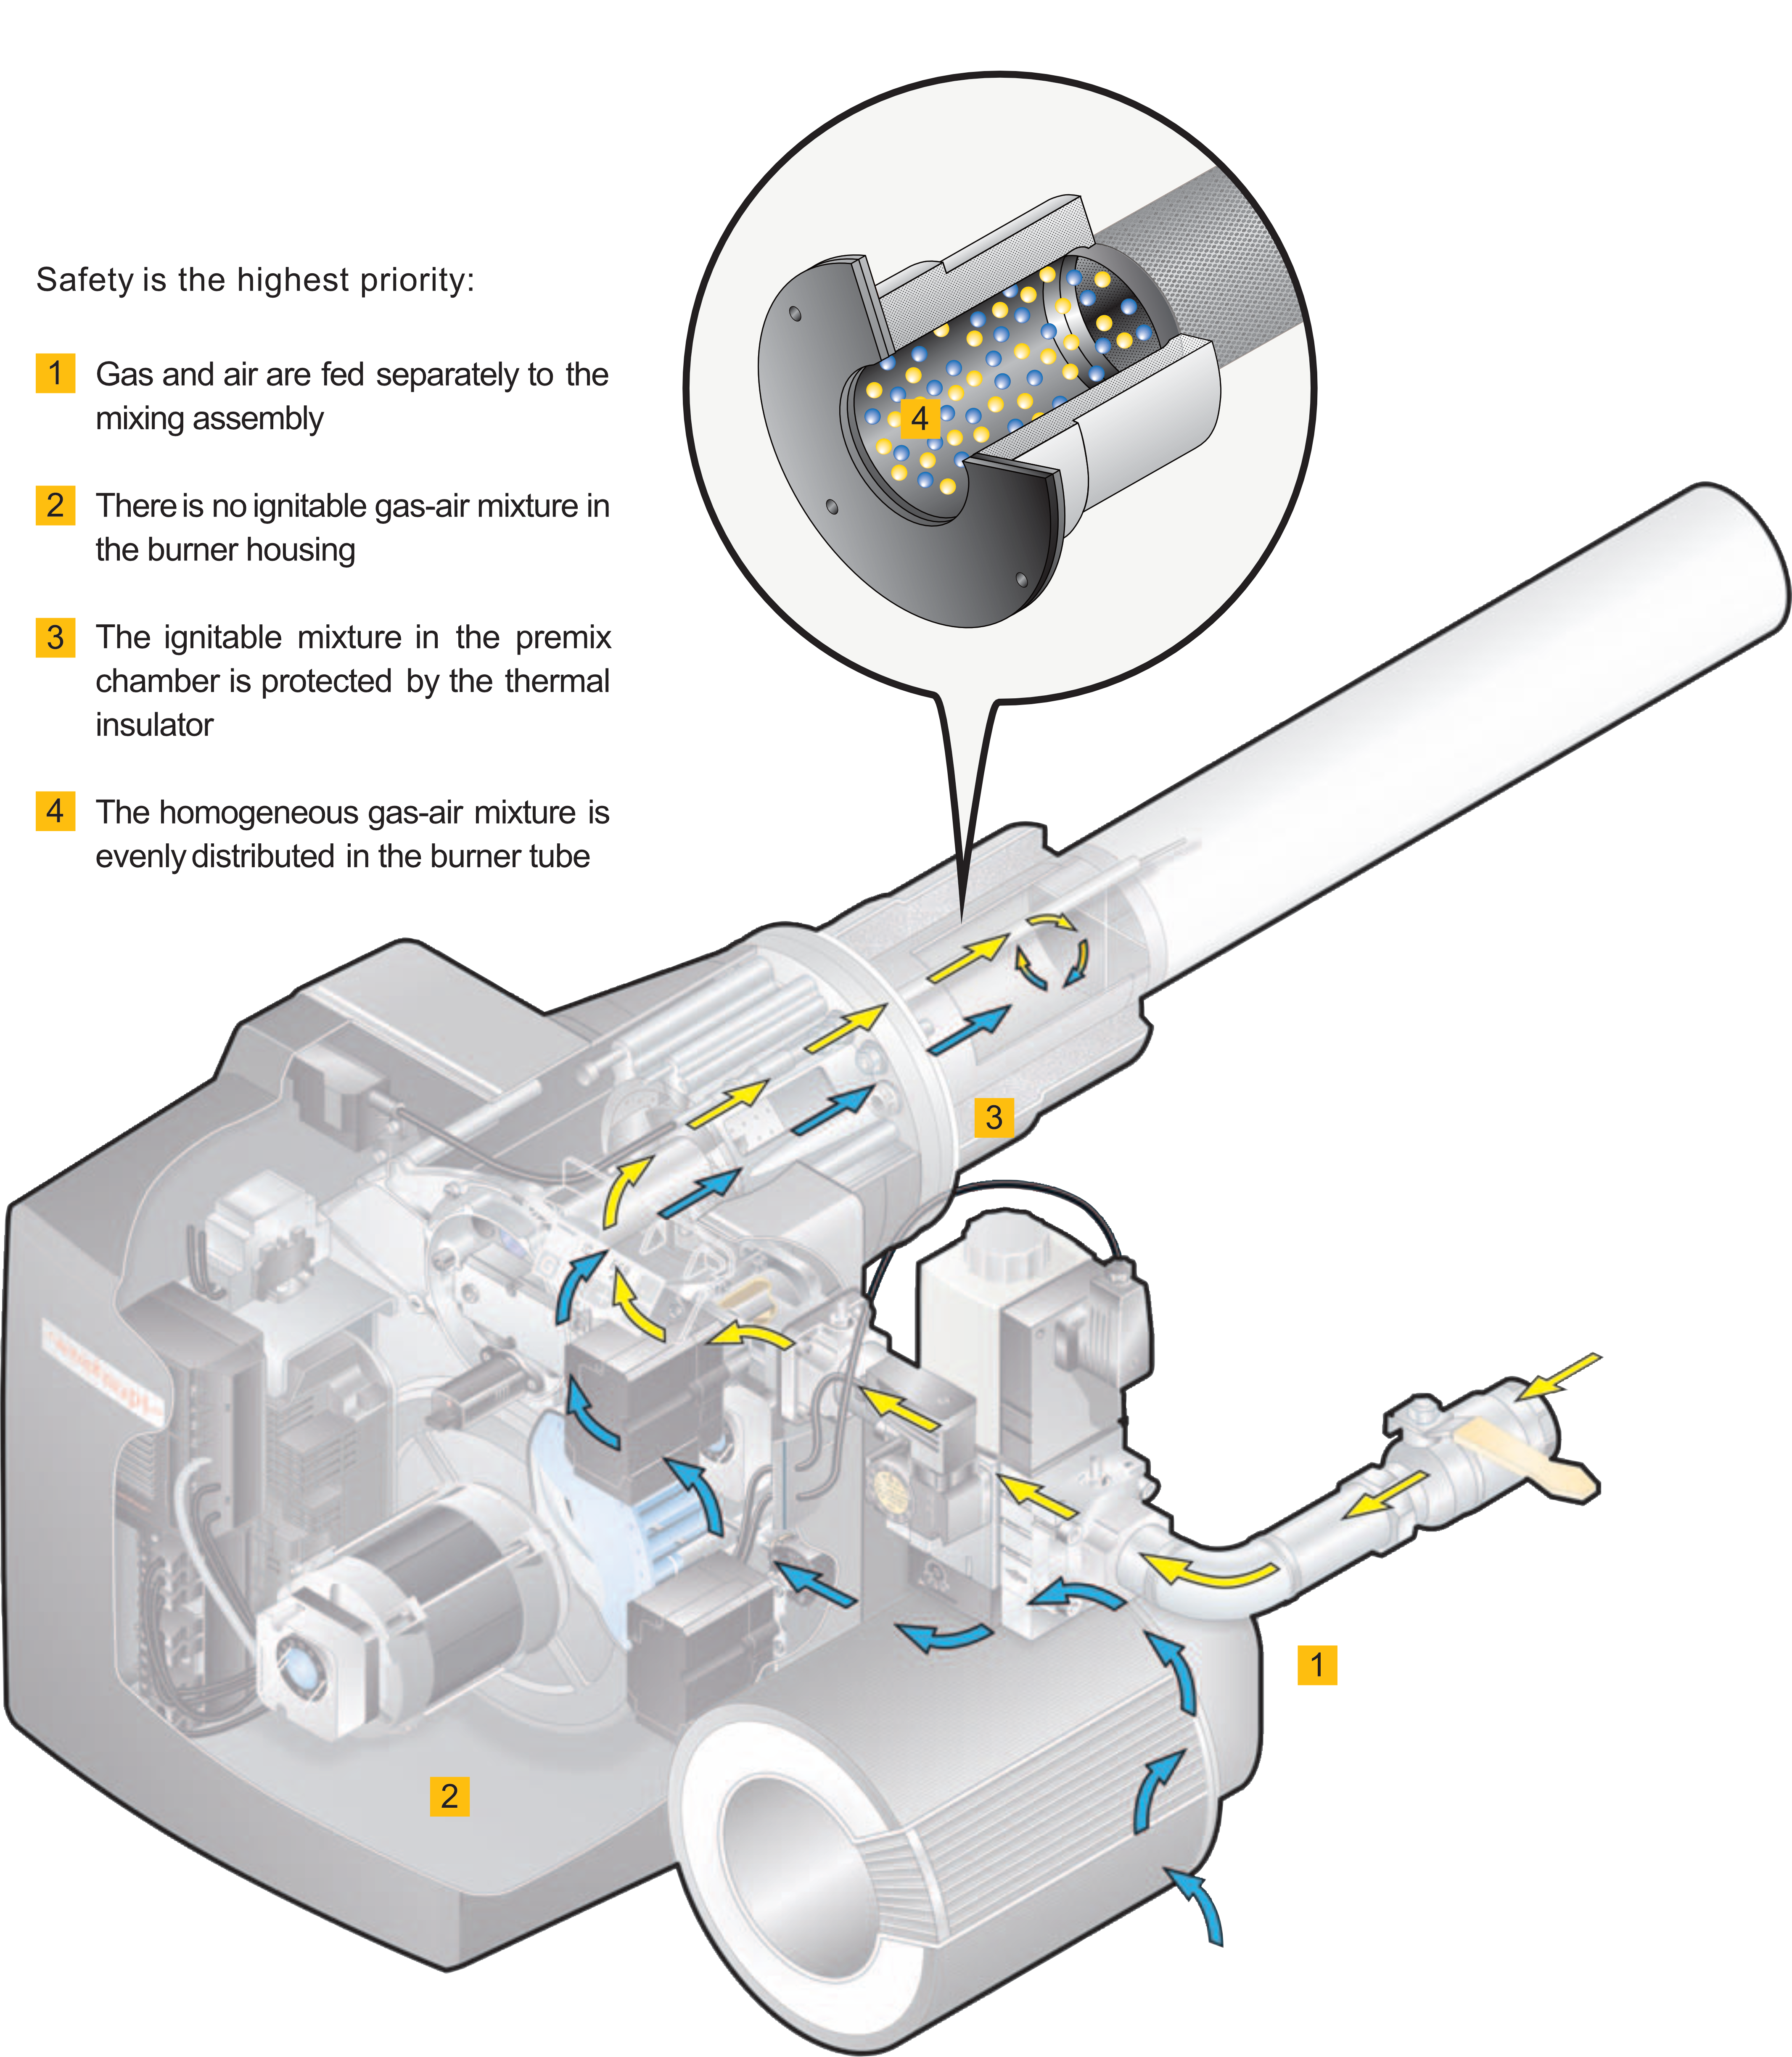
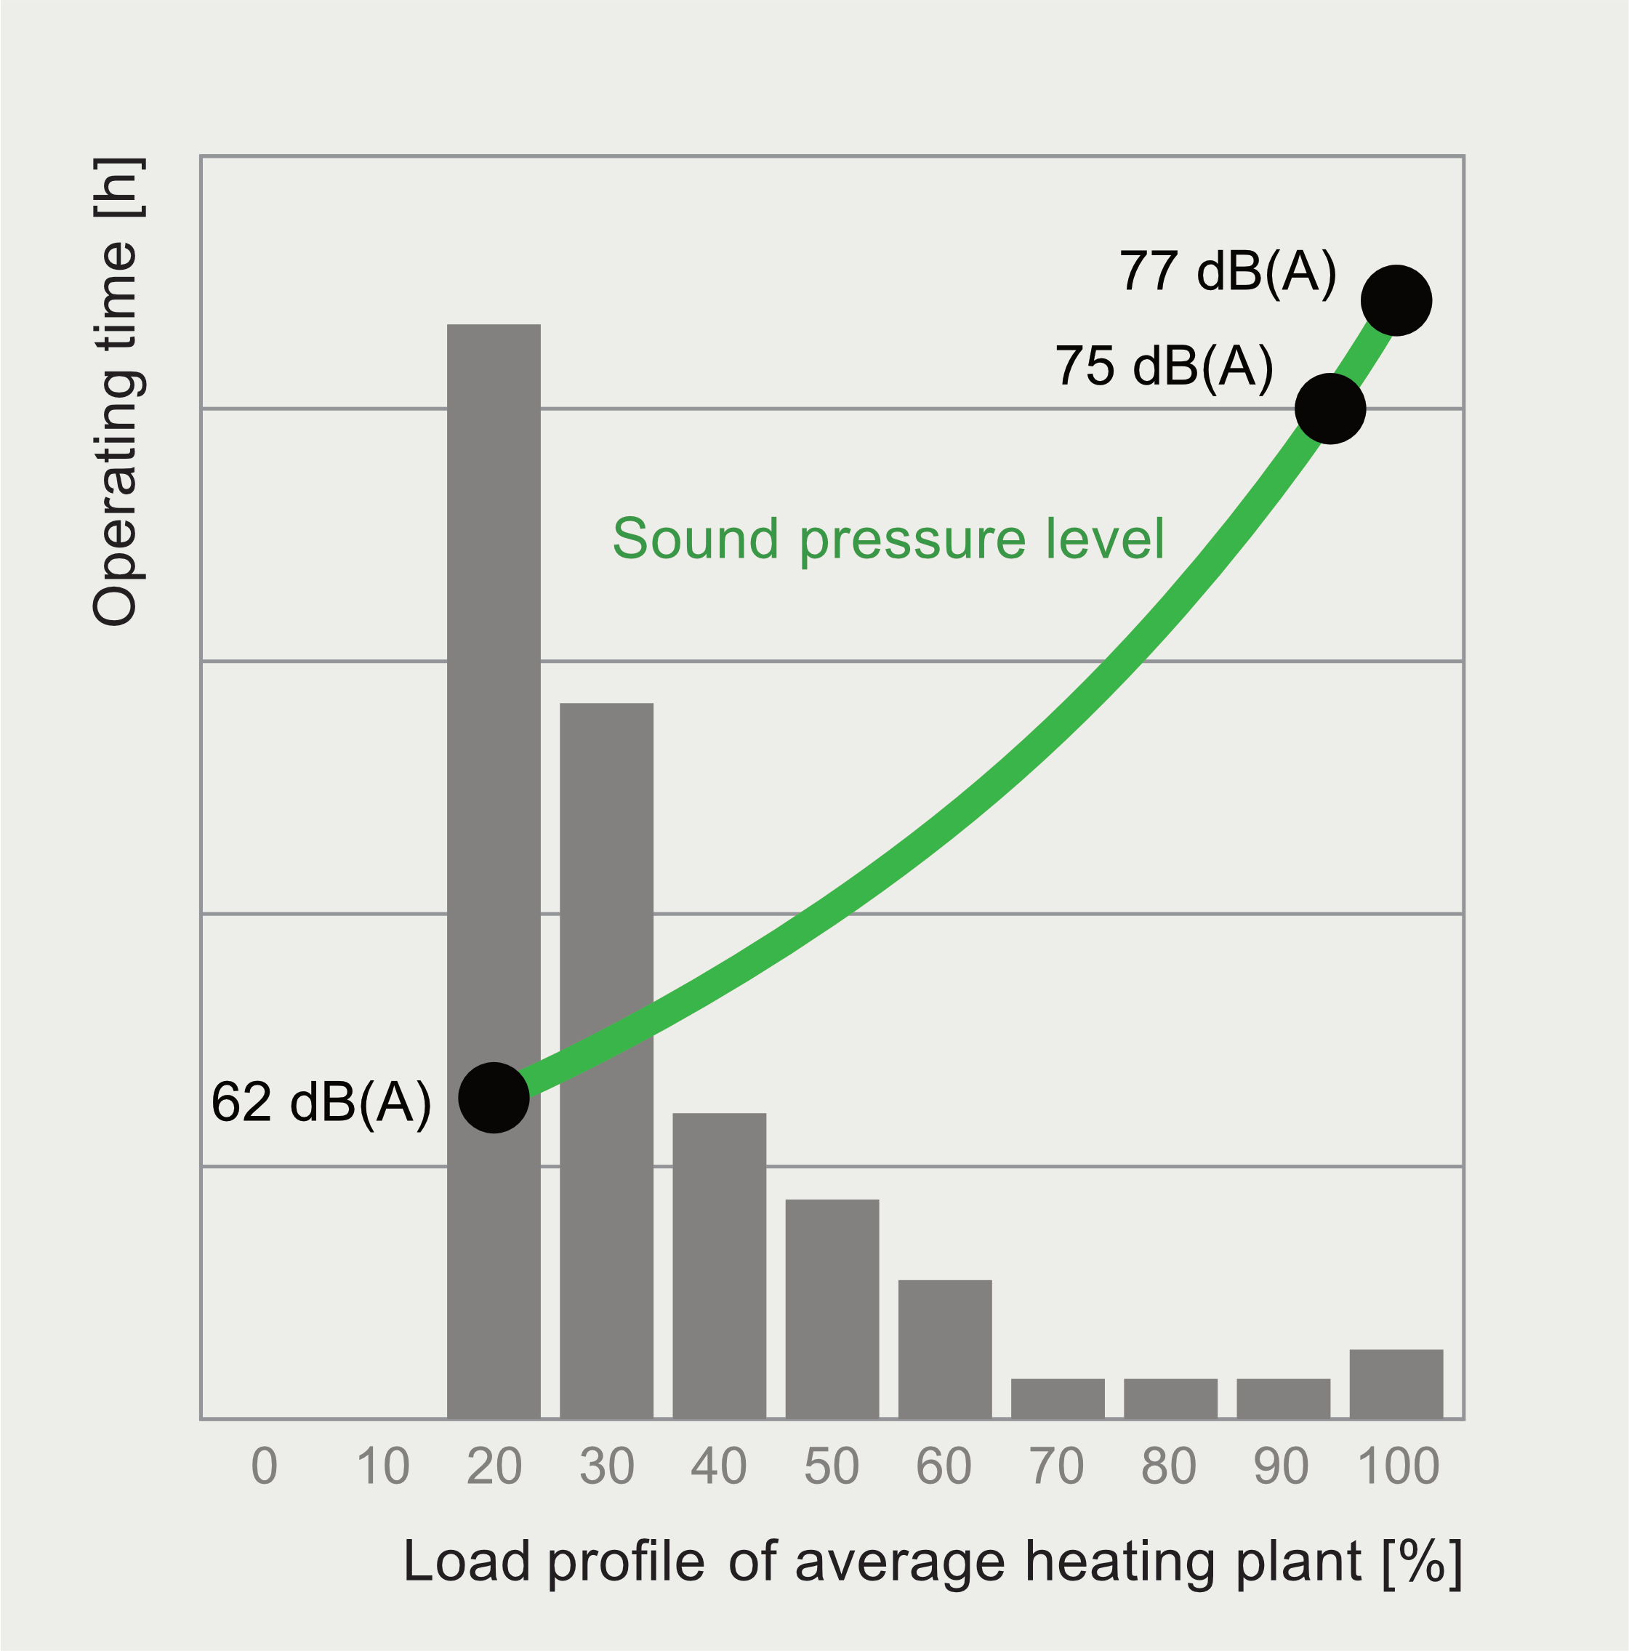

Slide 9
insulation
The use of a new insulation system based on glass fiber specially made for our ovens allows us to reduce dispersion by 24%
Compared to the ceramic fiber used in the previous Rotoplastic generation and by 37% compared to the traditional machines on the market

Slide 10
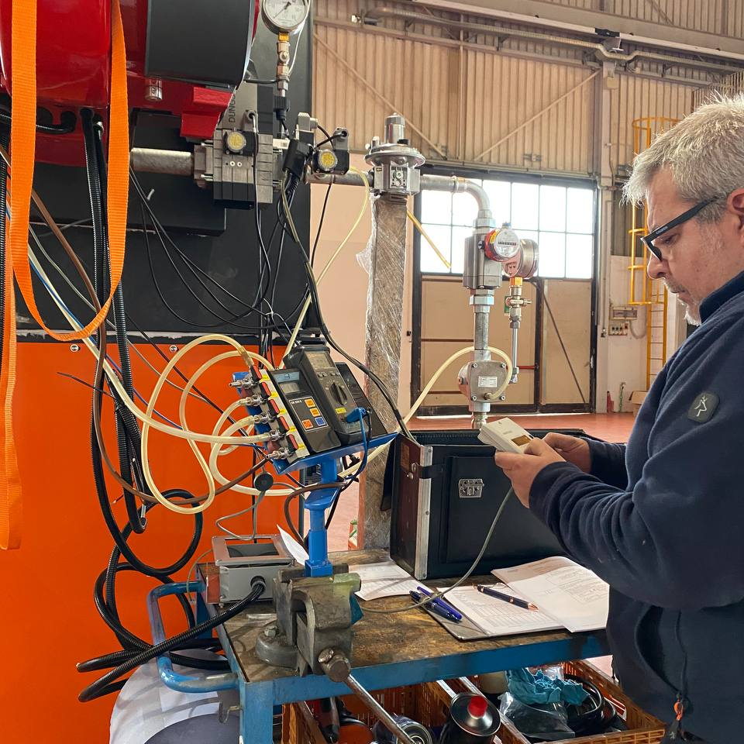
UNI 10389
If the CO concentration reported to the condition of
Dry combustion products without air is greater
by 0.1% (1 000 ppm), and it cannot be traced back
below this value by the intervention of the conductor or maintainer, the outcome of the audit of combustion as to be considered negative, regardless of the measured value of the combustion efficiency
Permitted limit CO2 in fumes with METHANE fuel is 11,7

Slide 11
The evaluation of emissions
Like CO, oxygen O2 is a component of combustion result, the worse the combustion is, the greater the measurements of the two gases in emissions are
Based on the Weishaupt document : (O2 and CO2 content in fumes as a function of air coefficient) the O2 limits with an air coefficient between 1.0 and 1.99
The higher the coefficient is, the worse the combustion and therefore the efficiency of the burner are

Slide 12
Considerations
WHY THE OLDER GENERATION IS OBSOLETE
The excess air over 6% is necessary to maintain carbon monoxide (CO) which would otherwise be beyond the 200PPM.
The excess air reduces the efficiency of the flame that will have a much lower core temperature, therefore increases the consumption of gas for the generation of the same conversion energy
The increase in consumption also generates an increase in the need for GAS which, with the same processing, increases the amount of CO2 emitted as a percentage of daily production

Slide 13
WE COMPARE DATA
Hybrid Generation 2023 Rotoplastic
Maximum resulting oxygen remaining from combustion on average 4,6%
Keeping the excess air low allows to keep the carbon monoxide CO under control but at the same time to significantly increase the flame yield and therefore the optimization of consumption
Coefficient 1,31%
Maximum emission of Co2 9,2%
Average CO emission 7,6 PPM
Average emission of NOx 30,8 PPM
Average air pressure a Pu 18,79 mBar
Older generation with vertical combustion chamber open flame
Maximum resulting oxygen remaining from combustion on average 6,48%
The excess air over 6% is necessary to maintain carbon monoxide (CO) which would otherwise be beyond the 200PPM excess air reduces the efficiency of the flame which will have a much lower core temperature, thus increasing gas consumption
Coefficient 1,48%
Maximum emission of Co2 7,9%
Average CO emission 33 PPM
Average emission of NOx 54,9 PPM
Average air pressure a Pu 13,55 mBar

Slide 14
DATA SHOULD BE READ CAREFULLY
WITH TRADITIONAL MACHINES THE DATA ARE READ AN OPEN FLAME, AND THEN DILUTED BY THE PROCESS AIR THAT INVESTS THE PROBE, THE DATA COLLECTED ARE NOT VERY TRUTHFUL BUT WE WILL STILL USE THE DATA COLLECTED AS A SAMPLE.
WITH THE EXCHANGER CLOSED THE DATA READ ARE REAL AND PRECISE, IT IS CLEAR THAT:
THE COMBUSTION RATIO IMPROVES FROM 1,48% TO 1,31%
THE PRESSURE OF THE CHAMBER INCREASES BY 28% INCREASING THE MASS 1.28
THE PROCESS IS MORE EFFICIENT: WE TALK ABOUT THE 12% IMPROVEMENT
CO EMISSIONS WILL BE REDUCED BY 76% ON BASE 1.28 THEREFORE: AT CONSTANT PRESSURE 83% LESS
CO2 EMISSIONS WILL INCREASE BY 14% ON BASE 1.28 THEREFORE: AT CONSTANT PRESSURE -10%
NOX EMISSIONS WILL BE REDUCED BY 48% ON BASE 1.28 THEREFORE: AT CONSTANT PRESSURE -70%

Slide 15
HOW THE NEW DIRECTIVE FOR INDUSTRY 5.0
CAN HELP US TO REDUCE EMISSIONS

Slide 16
What is Industry 5.0?
European industry is a key driver in the economic and societal transitions that we are currently undergoing.
In order to remain the engine of prosperity, industry must lead the digital and green transitions.
This approach provides a vison of industry that aims beyond efficiency and productivity as the sole goals, and reinforces the role and the contribution of industry to society.
It places the wellbeing of the worker at the centre of the production process and uses new technologies to provide prosperity beyond jobs and growth while respecting the production limits of the planet.
It complements the existing "Industry 4.0" approach by specifically putting research and innovation at the service of the transition to a sustainable, human-centric and resilient European industry.

Slide 17
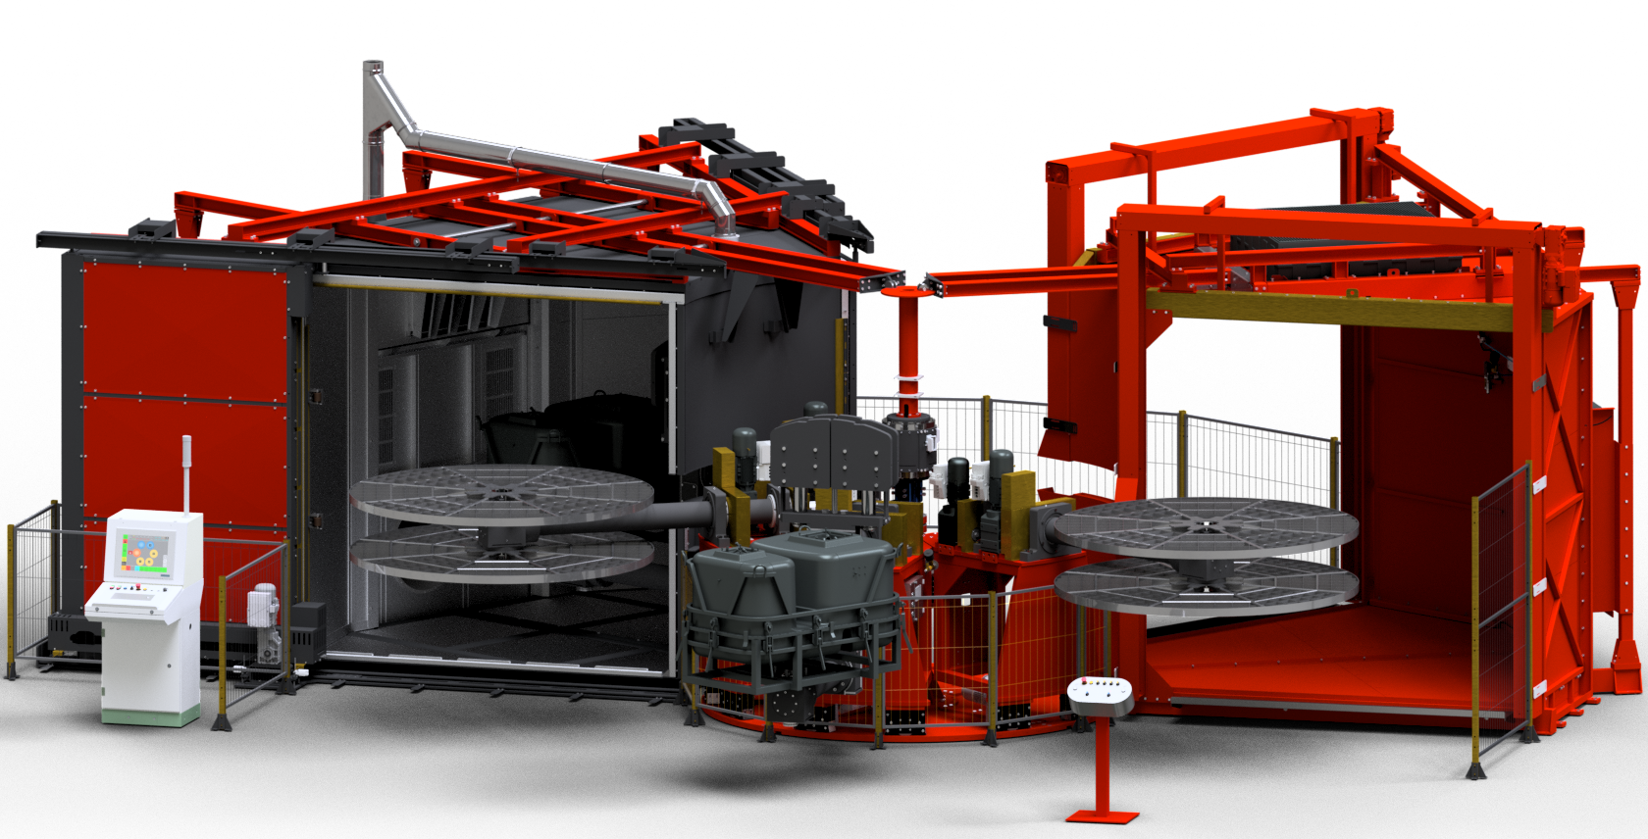

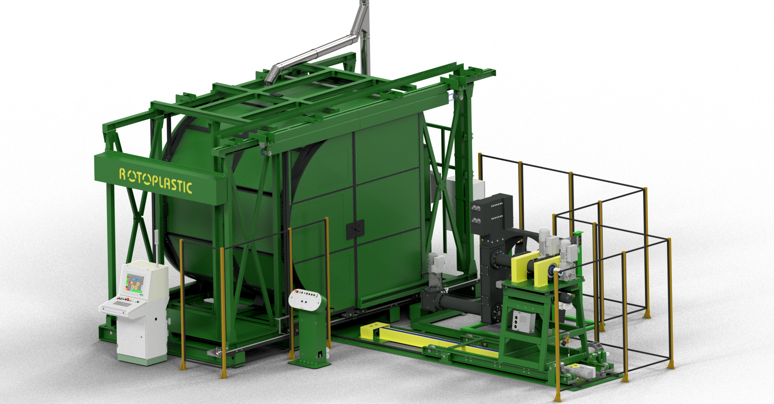



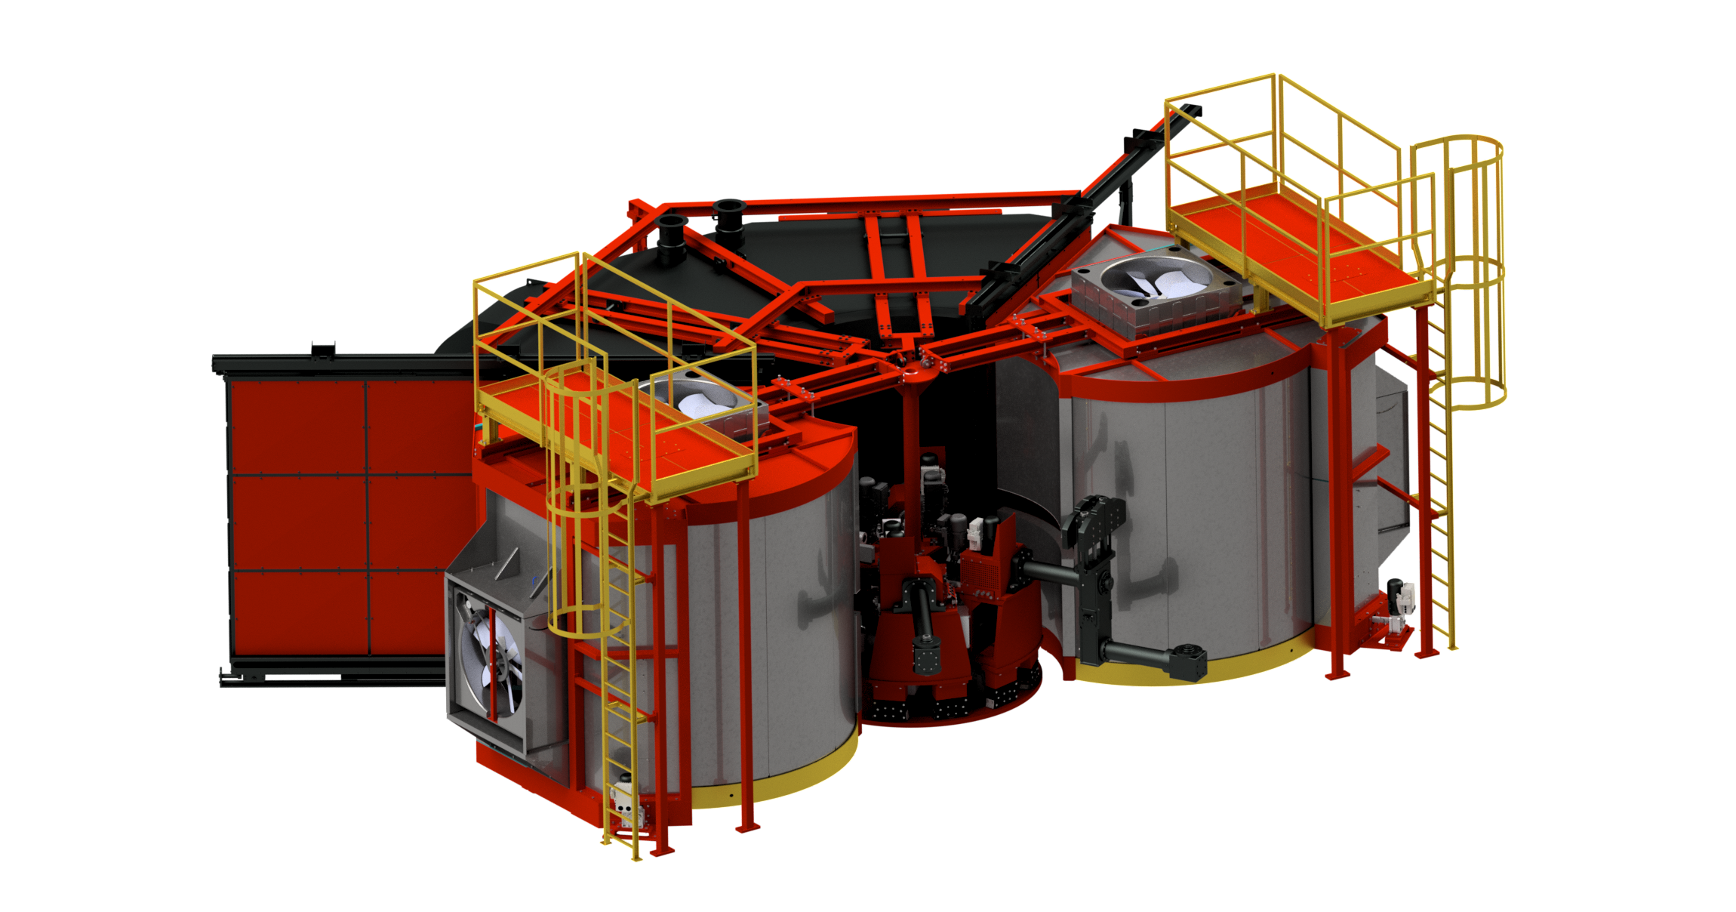

REMOTE CONTROL
LONG TIME STORAGE
24h STORAGE

Slide 18
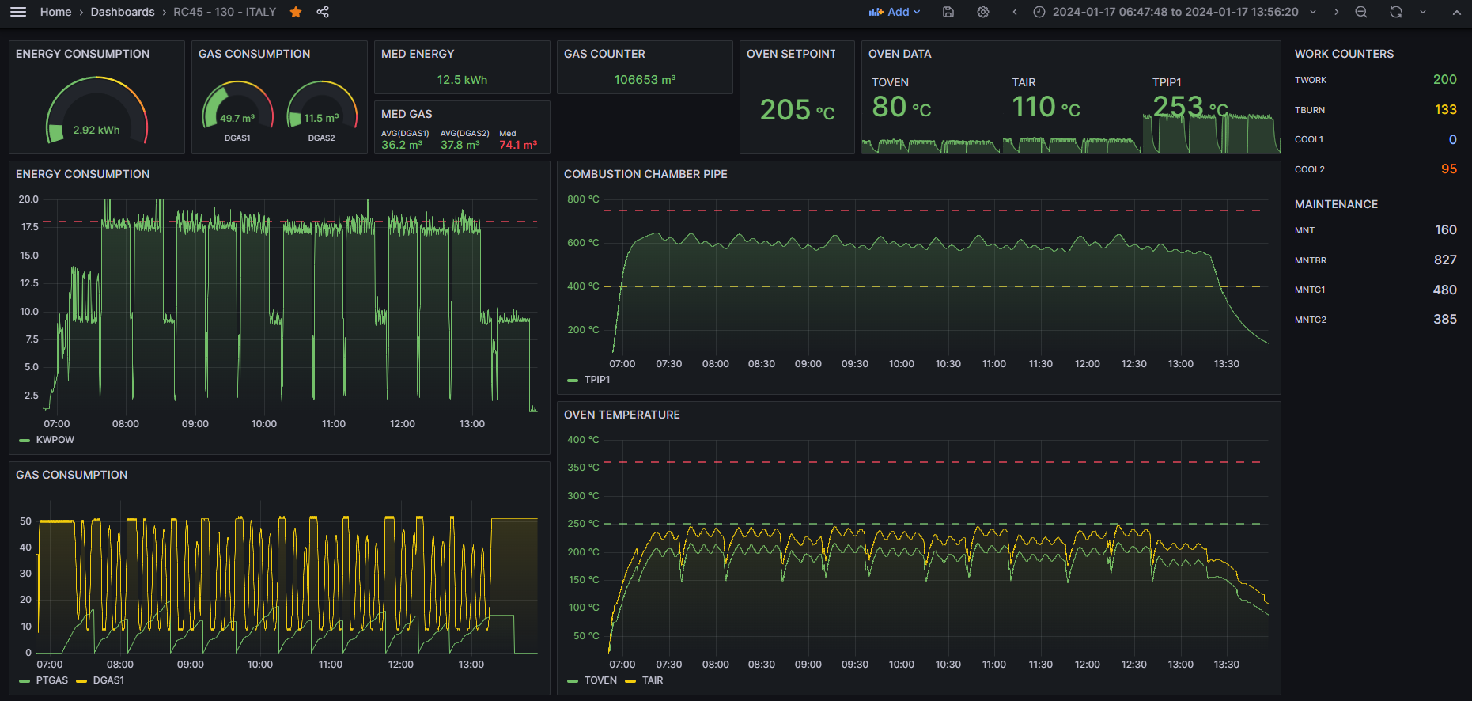
REMOTE DASHBOARD

Slide 19
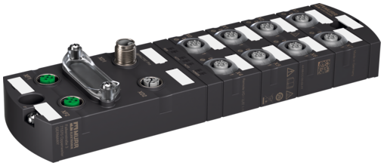



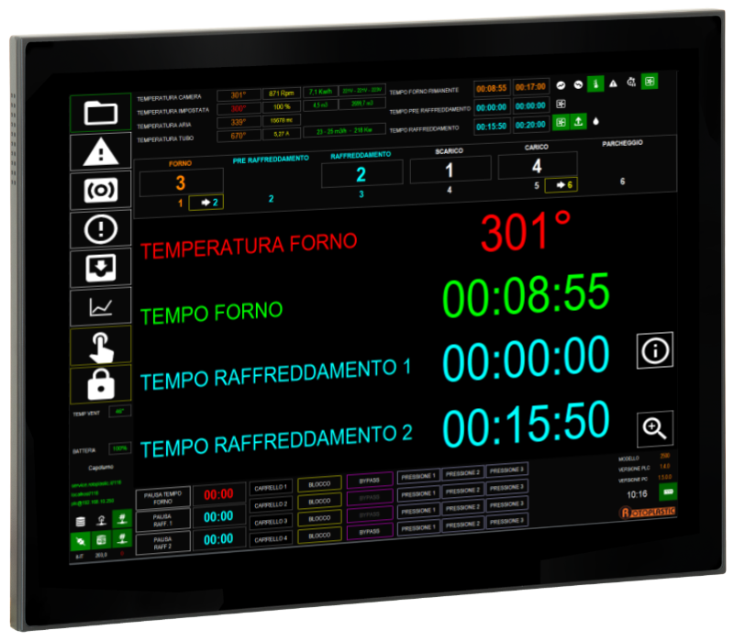
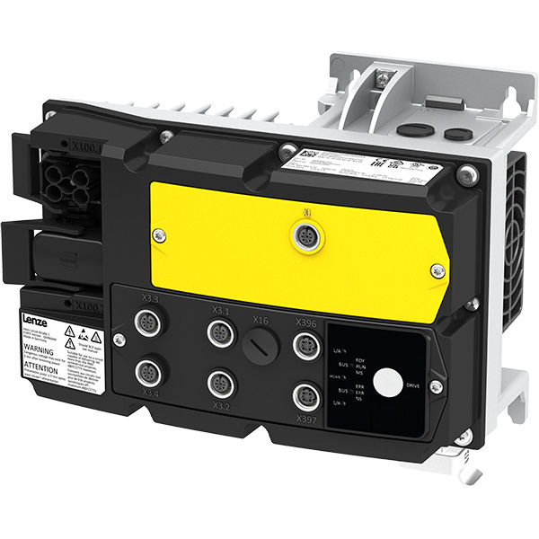

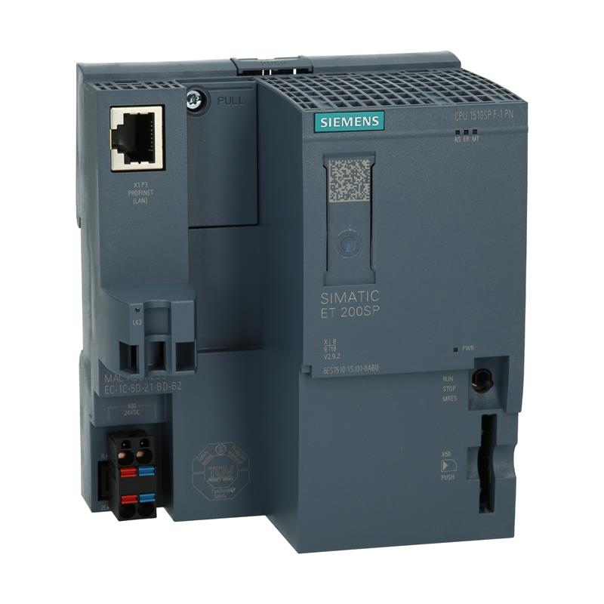

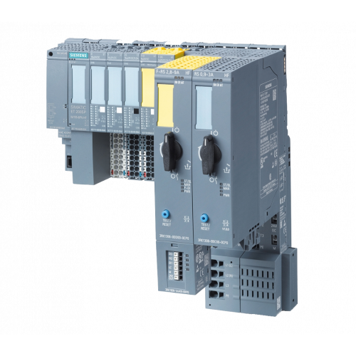

LOCAL CONTROL
MACHINE
HARDWARE
SOFTWARE
DATA
LONG TIME STORAGE
.NET 8.0
XAML
C#

Slide 20
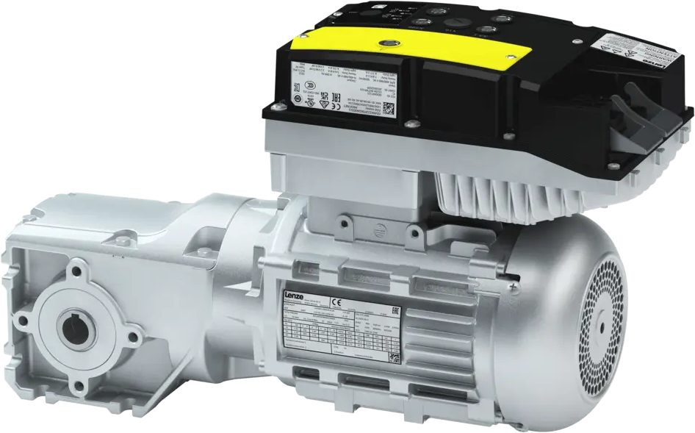
HARDWARE LAYER
REMOTE DEVICE
DIGITAL MOTORS CONTACTORS
INTEGRATED ENERGY SAVING
REMOTE DRIVE MOUNTED ON MOTORS
SAFETY INTEGRATED
LOW ELECTROMAGNETIC EMISSION
ENCODER FEEDBACK CONTROL
POWER REGENERATION INTEGRATED
ZERO WIRES CONNECTION
REMOTE EVALUATION CONTROL
IO-LINK INTELLIGENT SENSORS

Slide 21

MES
NO
SETUP
OK
YES
NO
USER
OK
YES
OPEN PRODUCTION ORDER
WRITE DB INFORMATIONS
PRODUCTION START
WRITE DB INFORMATIONS
CLOSE PRODUCTION ORDER
CARRIAGE CYCLE START
OVEN CYCLE
NOTIFICATION END
COOL 1 CYCLE
COOL 2 CYCLE
YES
NO
QTY OK
END CYCLE
START NEXT
PART
OK?
YES
WASTE DISCARD
NO
LABELING PART OK
COUNTER INCREMENT

Slide 22
CONCLUSIONS

Slide 23
ROTOPLASTIC SKILLS
ARMS WITH 3 AIR HIGH PRESSURE
WATER COOLING FOR INTERNAL MOULD INSIDE THE ARM
ARMS NOT WELDED
CUSTOMIZATION
REMOTE ASSISTANCE
300K€ STOCK OF STRATEGIC SPARE PARTS

Slide 24
COMBUSTION MANAGEMENT
ENERGY MANAGEMENT
OVEN INSULATION WITH MODERN INSULATORS
OPTIMIZATION
ENERGY RECOVERY
DATA COLLECTION AND ANALYSIS
REAL TIME CONTROL WITH DASHBOARD ROTOPLASTIC
MORE EFFICIENT MACHINES AND DATA AGGREGATION FOR BETTER CONSUMPTION, EMISSIONS AND PRODUCTIVITY

